Slide 1

Course Levels
Level 0 Setup & Fundamentals Level 1 HTML Basics
Level 2 Must-Use HTML Tags Level 3 Browser Tools
Level 4 HTML and Project Structure Level 5 List, Tables & Forms
Level Bonus Github Pages & CodeSpace

Slide 2
Level 0
Setup & Fundamentals
IDE or Code Editor
What is IDE
Need of IDE
IDE Selection
Installation and Setup
VsCode Extensions
Website Components and Fundamentals
Client Side vs Server Side
FrontEnd / BackEnd / FullStack
Role of Browser
HTML
CSS
JS

Slide 3
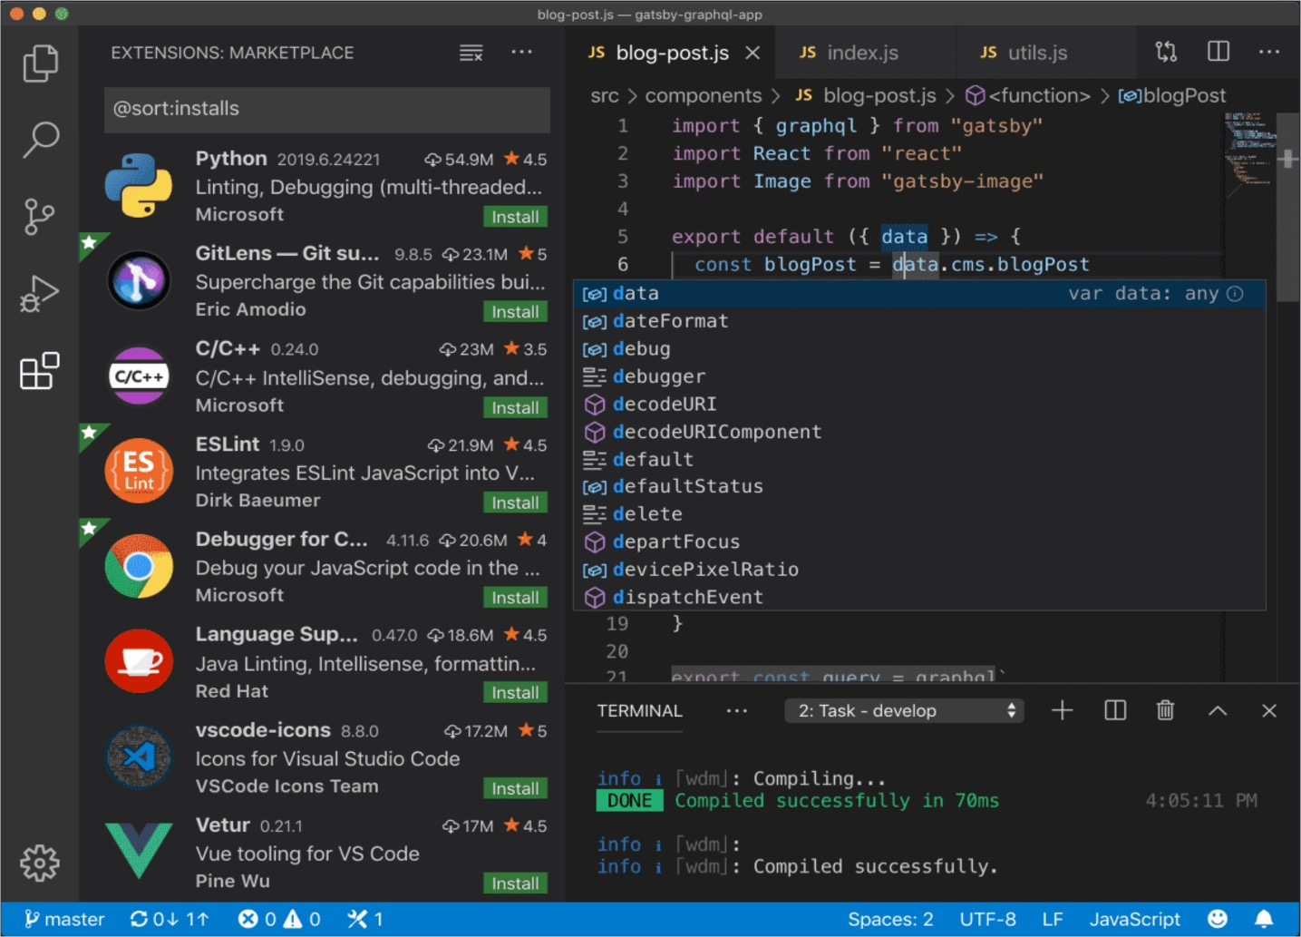
Level 0
Setup & Fundamentals
1. IDE OR
Code Editor

Slide 4

1.1 What is IDE
IDE stands for Integrated Development Environment.
Software suite that consolidates basic tools
required for software development.
Central hub for coding, finding
problems, and testing.
Designed to improve developer efficiency.

Slide 5
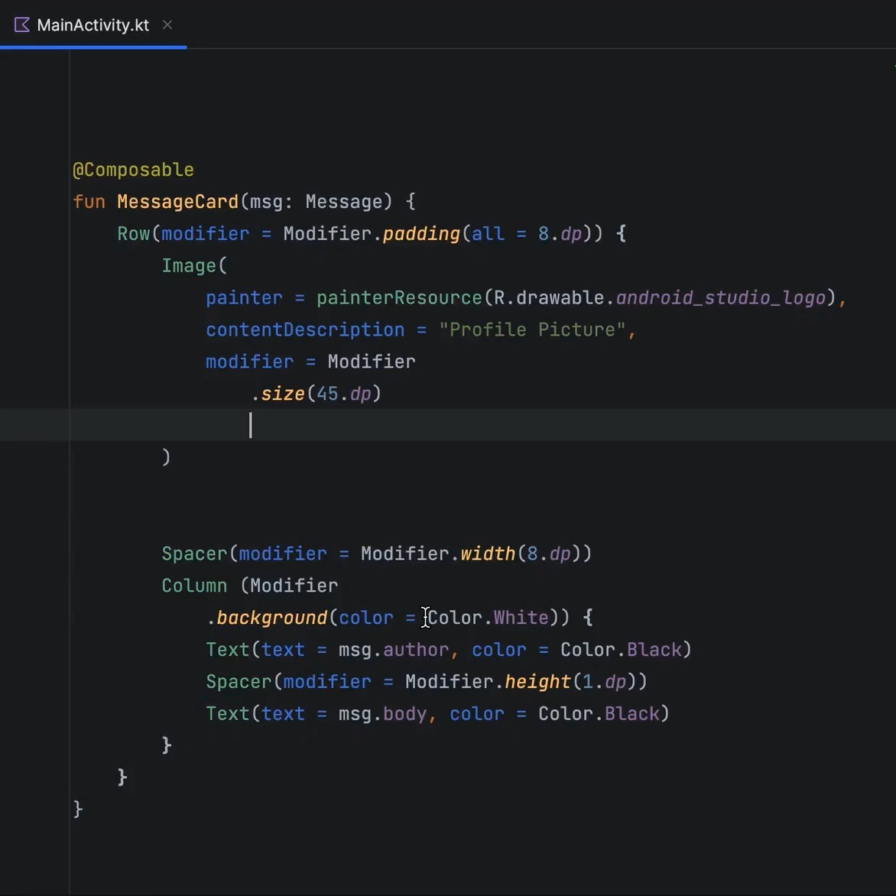
1.2 Need of IDE
Streamlines development.
Increases productivity.
Simplifies complex tasks.
Offers a unified workspace.
IDE Features
Code Autocomplete
Syntax Highlighting
Version Control
Error Checking

Slide 6


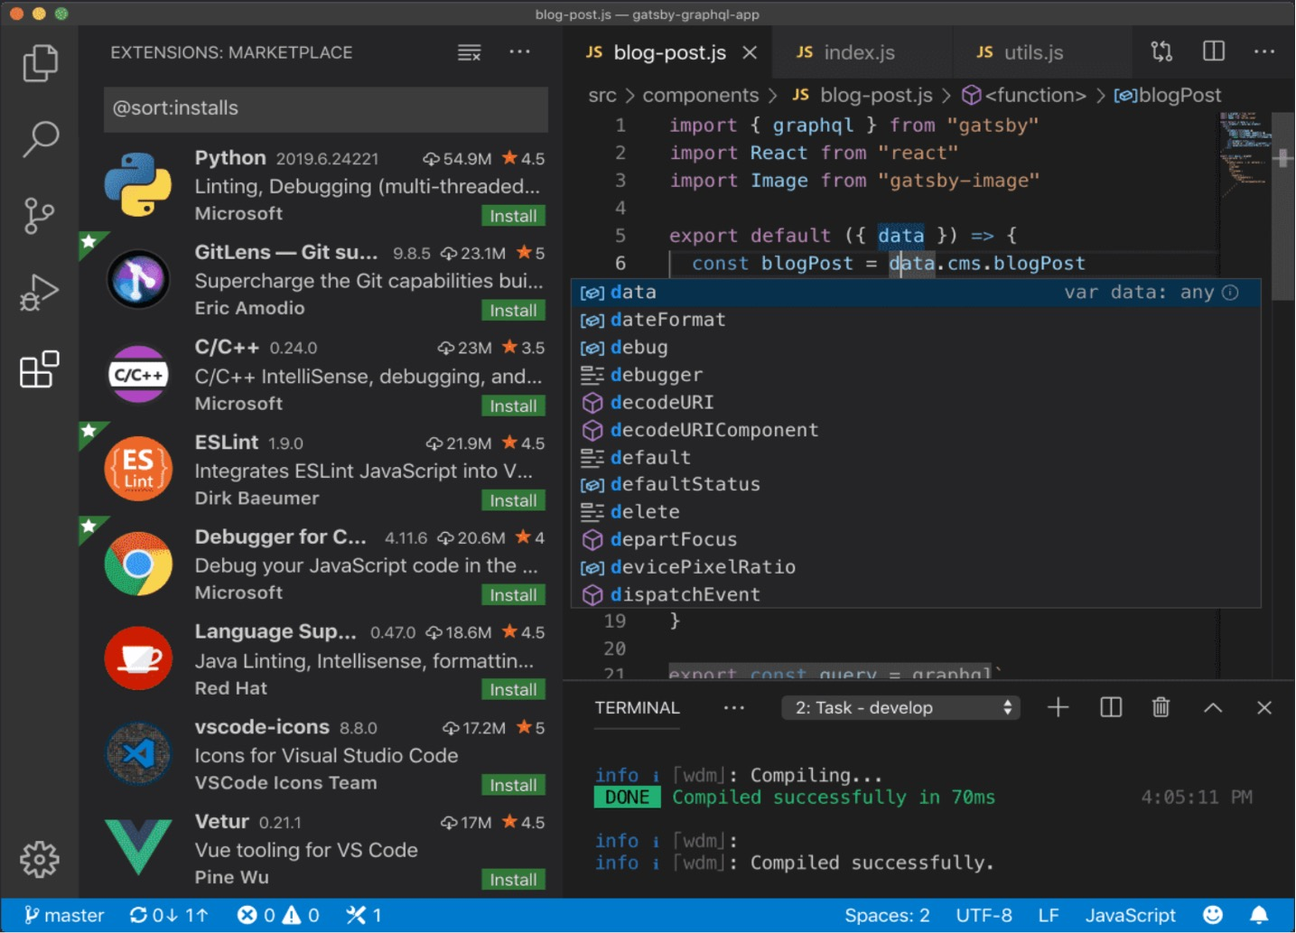


1.3 IDE Selection
Sublime Text
Atom
VS Code
Github CodeSpaces

Slide 7

1.4 Installation & Setup
1. Search VS Code

Slide 8



1.5 VsCode Extensions
Live Server
Prettier

Slide 9
Level 0
Setup & Fundamentals
2. Website Components
And Fundamentals

Slide 10
2.1 Client Side vs Server Side
 | Client Side | Server Side
Execution Location | Executes on user's device. | Executes on a remote machine.
Languages | Primarily JavaScript, HTML, CSS. | PHP, Python, Java, Node.js, etc.
Main Job | Makes clicks and scrolls work | Manages saved information
Access Level | Can't access server data directly | Can read/write files, interact with databases.
Speed | Quicker for UI changes | Slower due to network latency.

Slide 11







2.2 FrontEnd / BackEnd / FullStack
Client Side / Front-End Web Development
Server Side Back-End
Full Stack

Slide 12
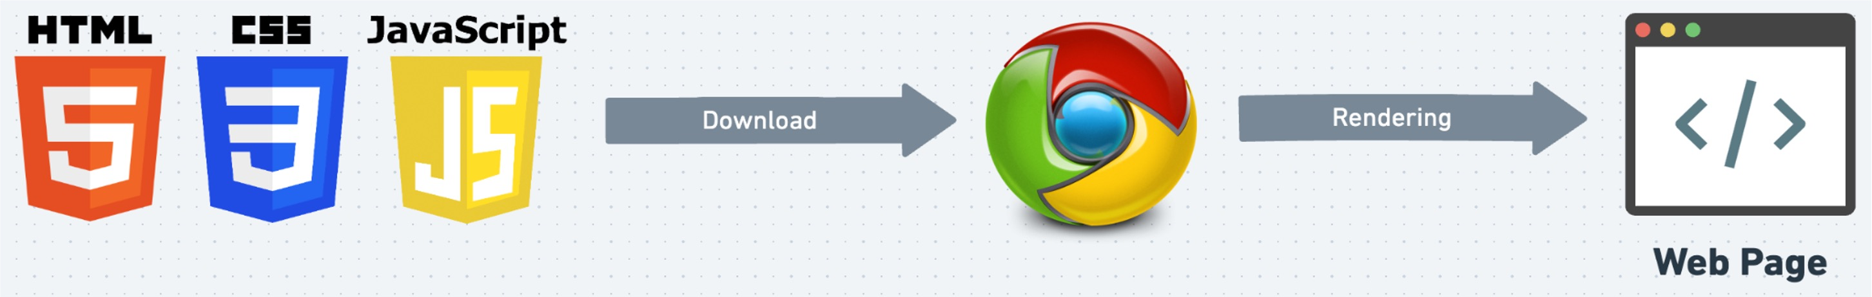
2.3 Role of Browser
Displays Web Page: Turns HTML code into what you see on screen.
User Clicks: Helps you interact with the web page.
Updates Content: Allows changes to the page using JavaScript.
Loads Files: Gets HTML, images, etc., from the server.

Slide 13


2.4 HTML
(Hypertext Markup Language)
Structure: Sets up the layout.
Content: Adds text, images, links.
Tags: Uses elements like
<p>, <a>.
Hierarchy: Organizes elements in a tree.

Slide 14

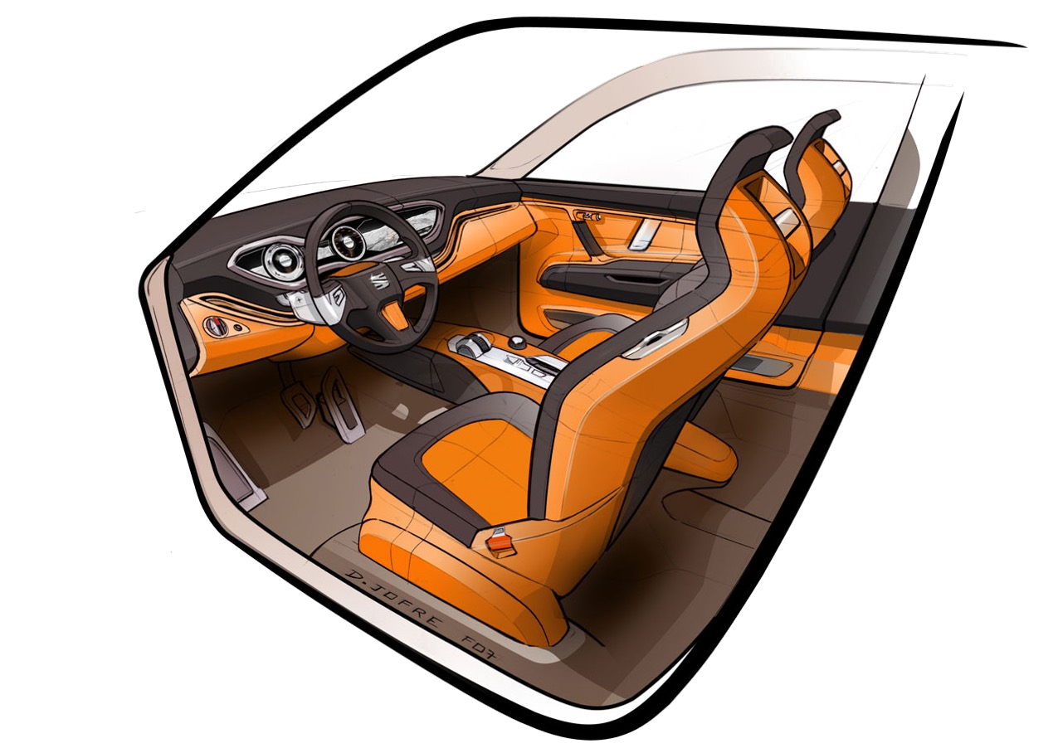
2.5 CSS
(Cascading Style Sheets)
Style: Sets the look and feel.
Colors & Fonts: Customizes text and background.
Layout: Controls position and size.
Selectors: Targets specific HTML elements.

Slide 15


2.6 JS
(Java Script)
JavaScript has nothing to do with Java
Actions: Enables interactivity.
Updates: Alters page without reloading.
Events: Responds to user actions.
Data: Fetches and sends info to server.

Slide 16

Level 0 Revision
Setup & Fundamentals
IDE or Code Editor
What is IDE
Need of IDE
IDE Selection
Installation and Setup
VsCode Extensions
Website Components and Fundamentals
Client Side vs Server Side
FrontEnd / BackEnd / FullStack
Role of Browser
HTML
CSS
JS

Slide 17
Level 1
HTML Basics
Starting up
First File using Text Editor
File Extension
Opening the project in VsCode
Index.html
Basics of HTML
What are Tags
Using Emmet ! to generate code
Basic HTML Page
MDN Documentation
Comments
Case Sensitivity

Slide 18

Level 1
HTML Basics
1. Starting Up

Slide 19

1.1 First file using Text Editor
Create a folder with name First Project on your Desktop.
Open Notepad.
Create a file and save it as index.html
Copy Sample code
Open Browser and Check.

Slide 20

1.2 File Extension
HTML
Most commonly used.
Works across all browsers.
Widely recognized and supported.
Typically saved as .html.
HTM
Less commonly used.
Originated for compatibility with older systems.
Works same as .html.
Typically saved as .htm.

Slide 21
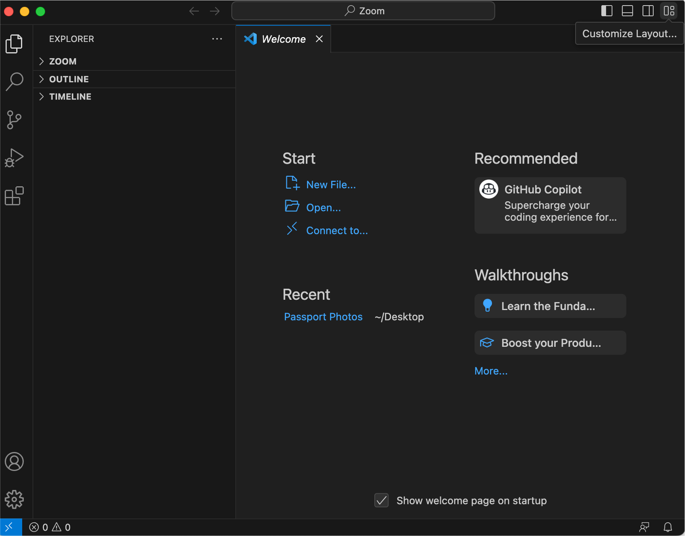
1.3 Opening project in VsCode

Slide 22
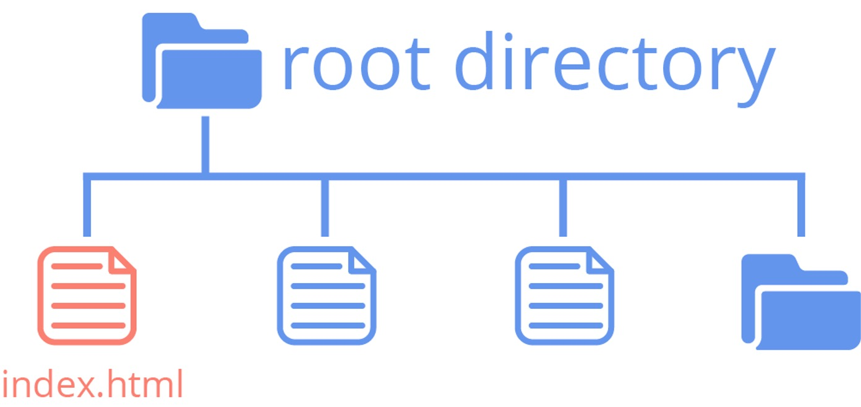
1.4 Importance of index.html
Default name of a website’s homepage.
First page users see when visiting a website
Important for SEO (Search Engine Optimization)
Provides uniform starting point
across servers
Serves as fallback when no file is specified in URL

Slide 23
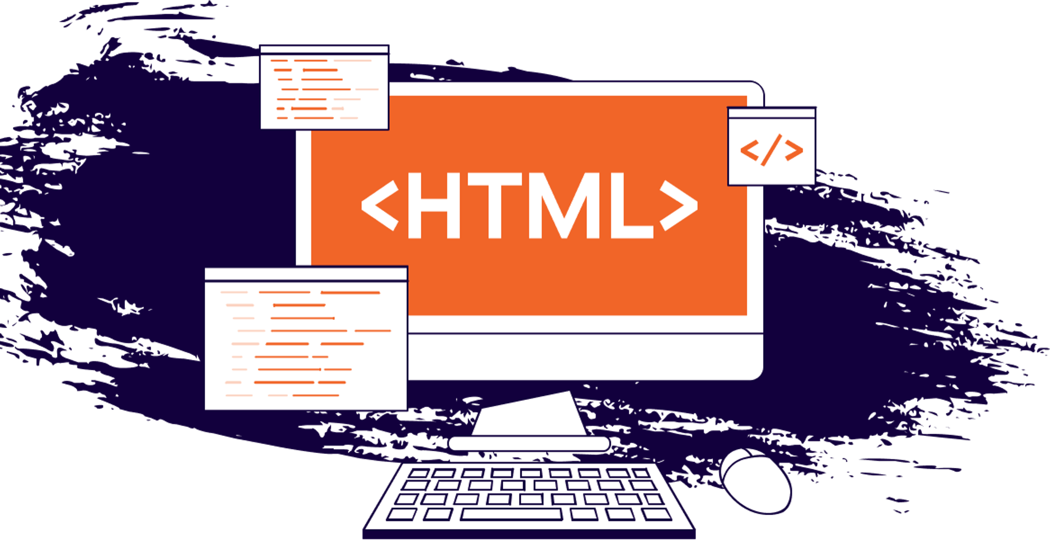
Level 1
HTML Basics
2. Basics of HTML

Slide 24
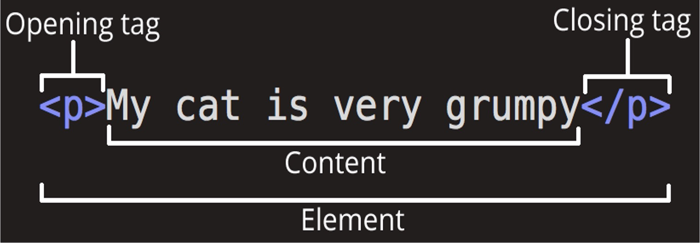
2.1 What are Tags
Elements that are used to create a website are called HTML Tags.
Tags can contain content or other HTML tags.
Define elements like text, images, links

Slide 25
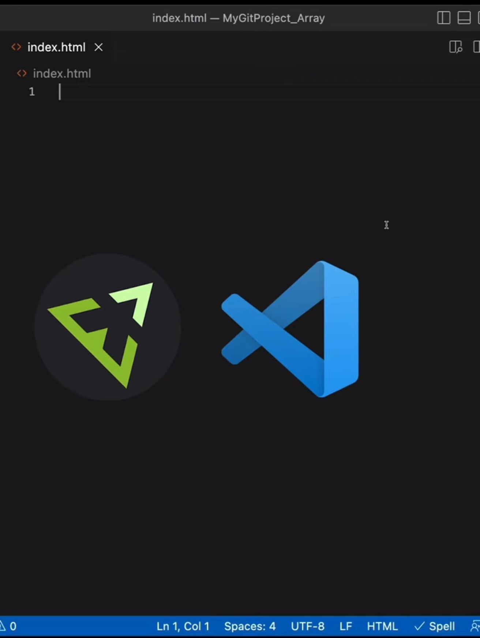
2.2 Using Emmet ! to generate code
1. Type ! and wait for suggestions.

Slide 26
2.3 Basic HTML Page
<!DOCTYPE html> Defines the HTML Version
<html lang="en"> Parent of all HTML tags / Root element
<head> Parent of meta data tags
<title>My First Webpage</title> Title of the web page
</head>
<body> Parent of content tags
<h1>Hello World!</h1> Heading tag
</body>
</html>

Slide 27
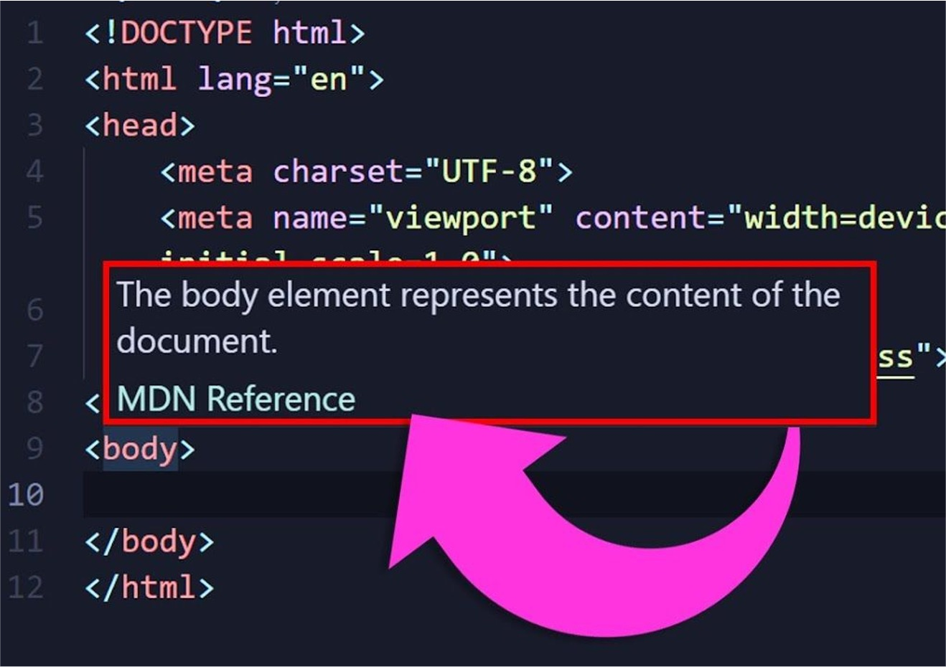
2.4 MDN Documentation
Visit https://developer.mozilla.org/
Official resource for HTML
Offers comprehensive guides and tutorials
Includes examples for real-world use
Updated with latest HTML features
Trusted by developers worldwide

Slide 28
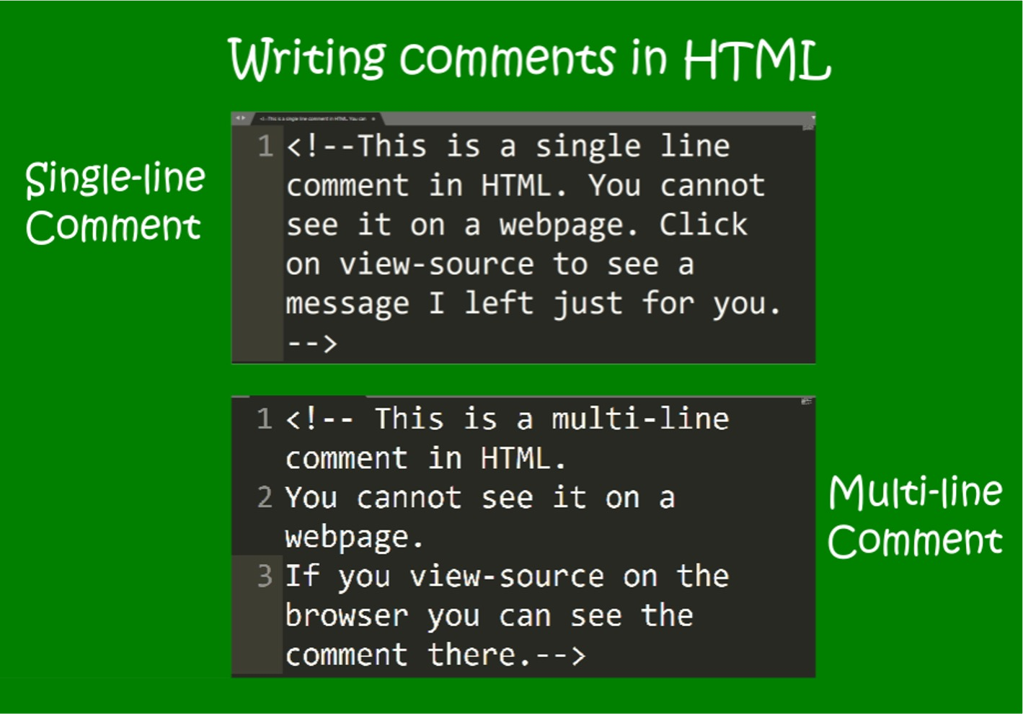
2.5 Comments
Used to add notes in HTML code
Not displayed on the web page
Syntax: <!-- Comment here -->
Helpful for code organization
Can be multi-line or single-line

Slide 29
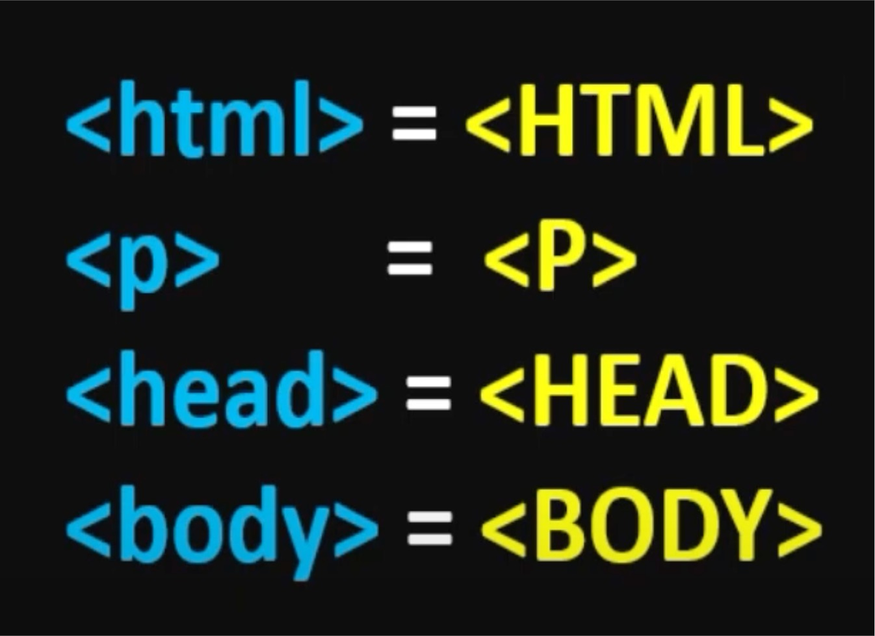
2.6 Case Sensitivity
HTML is case-insensitive for tag names
Attribute names are also be case-insensitive
Best practice: use lowercase for consistency

Slide 30

Level 1 Revision
HTML Basics
Starting up
First File using Text Editor
File Extension
Opening the project in VsCode
Index.html
Basics of HTML
What are Tags
Using Emmet ! to generate code
Basic HTML Page
MDN Documentation
Comments
Case Sensitivity

Slide 31

Project Level 1
HTML Basics
Create a new project with Index.html
Generate boilerplate code using Emmet
Write “I am learning with Prashant sir”
Use comments
Also use Case insensitive tags

Slide 32
Level 2
Must-Use HTML Tags
HTML Attributes
What are HTML Attributes
Id Property
HTML Tags
Heading Tag
Paragraph Tag
<BR> <HR> tags
Image Tag
Video Tag
Anchor Tag
Bold / Italic / Underline / Strikethrough
Pre Tag
Big / Small Tag
Superscript / Subscript
Character Entity Reference
What are Character Entity References

Slide 33
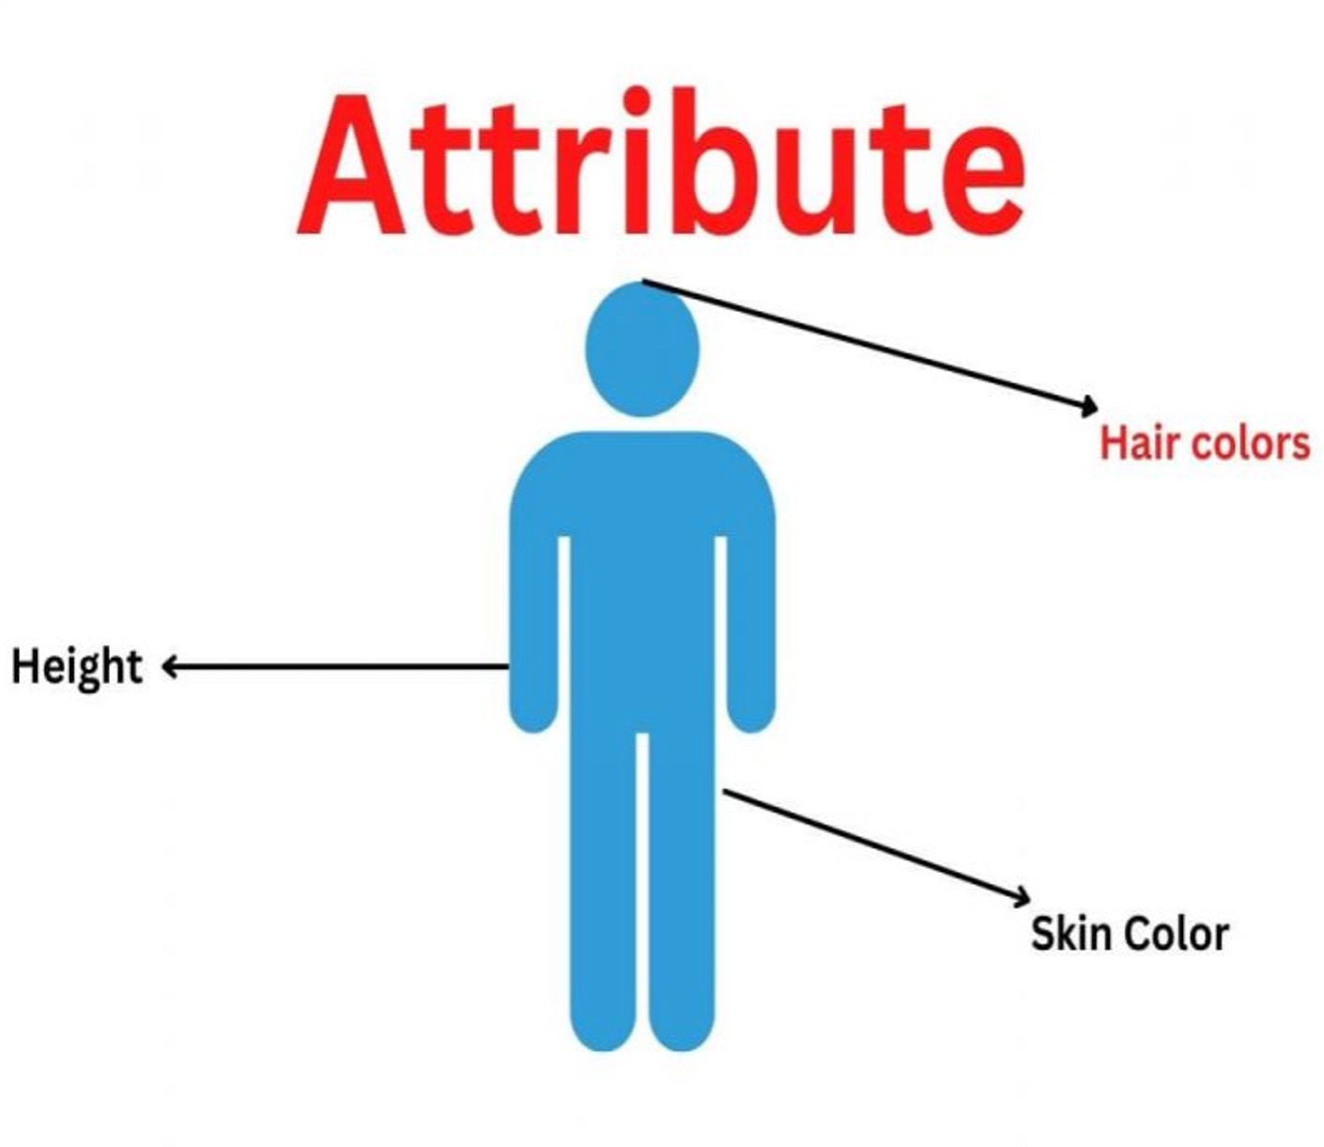
Level 2
Must-Use HTML Tags
1. HTML Attributes

Slide 34
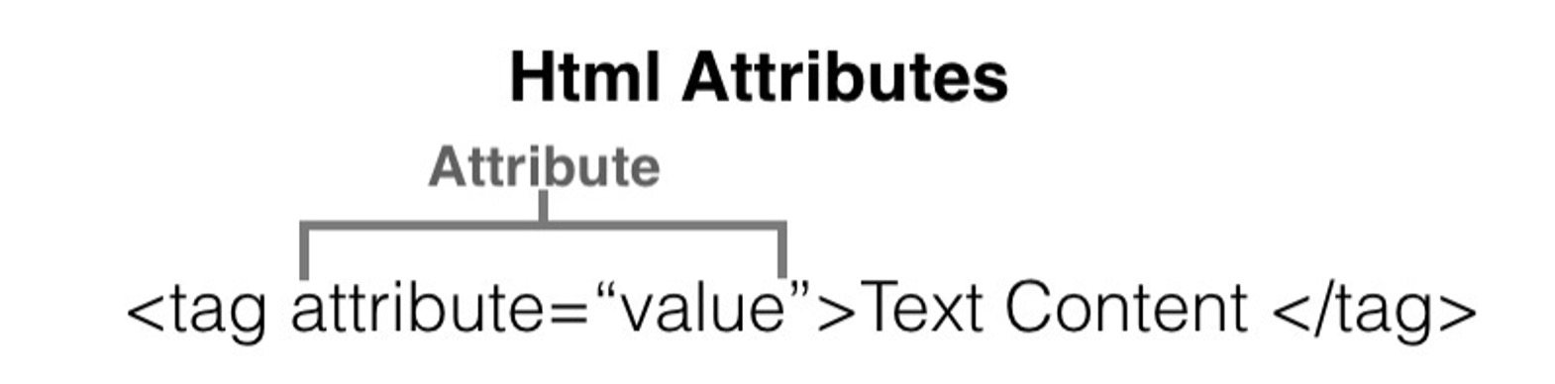
1.1 What are HTML Attributes?
Provides additional information about elements
Placed within opening tags
Common examples: href, src, alt
Use name=value format
Can be single or multiple per element

Slide 35
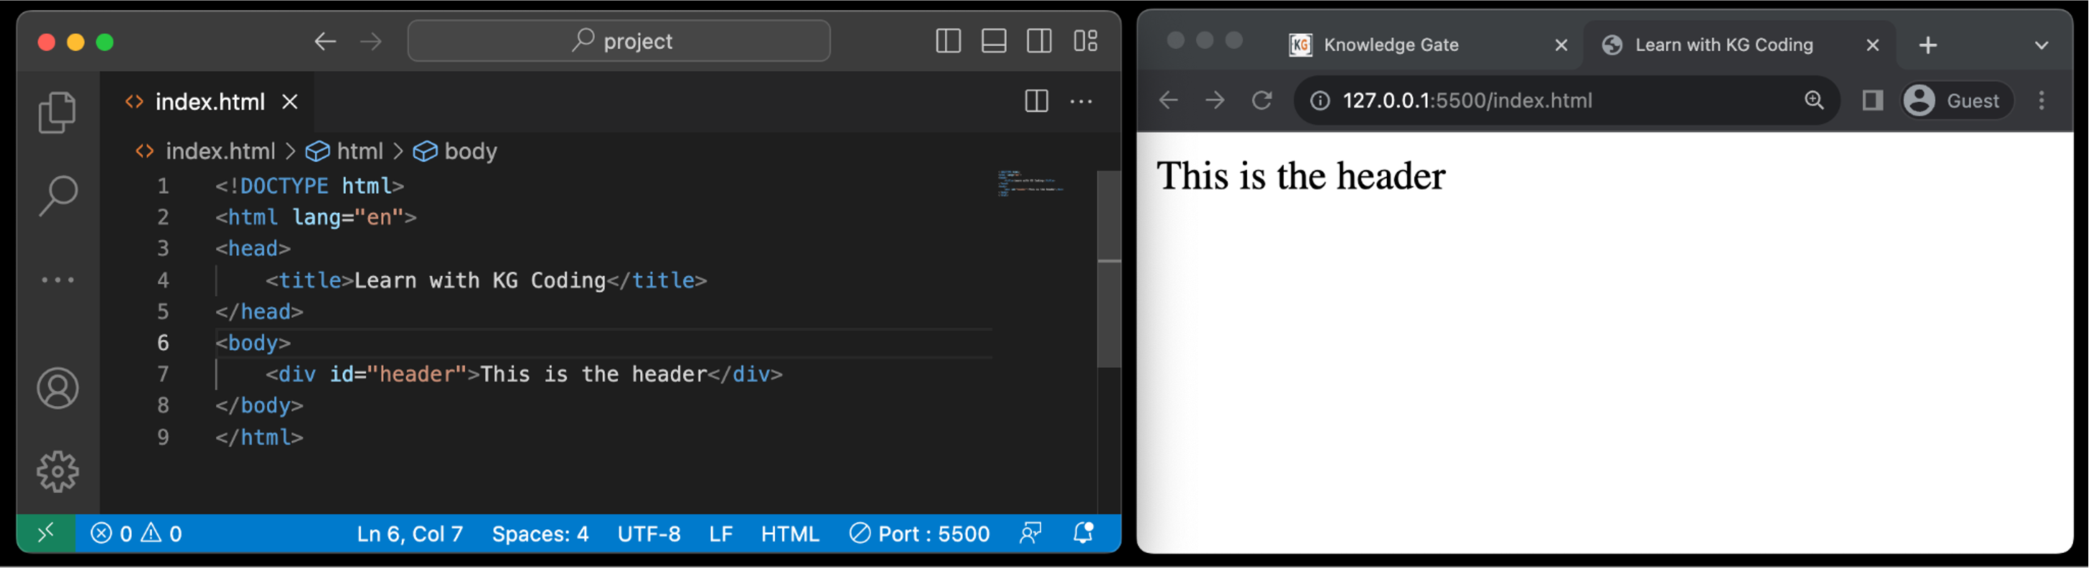
1.2 id property
Unique Identifier: Each id should be unique within a page.
Anchoring: Allows for direct links to sections using the #id syntax in URLs.
CSS & JavaScript: Used for selecting elements for styling or scripting.

Slide 36

Level 2
Must-Use HTML Tags
2. HTML Tags

Slide 37
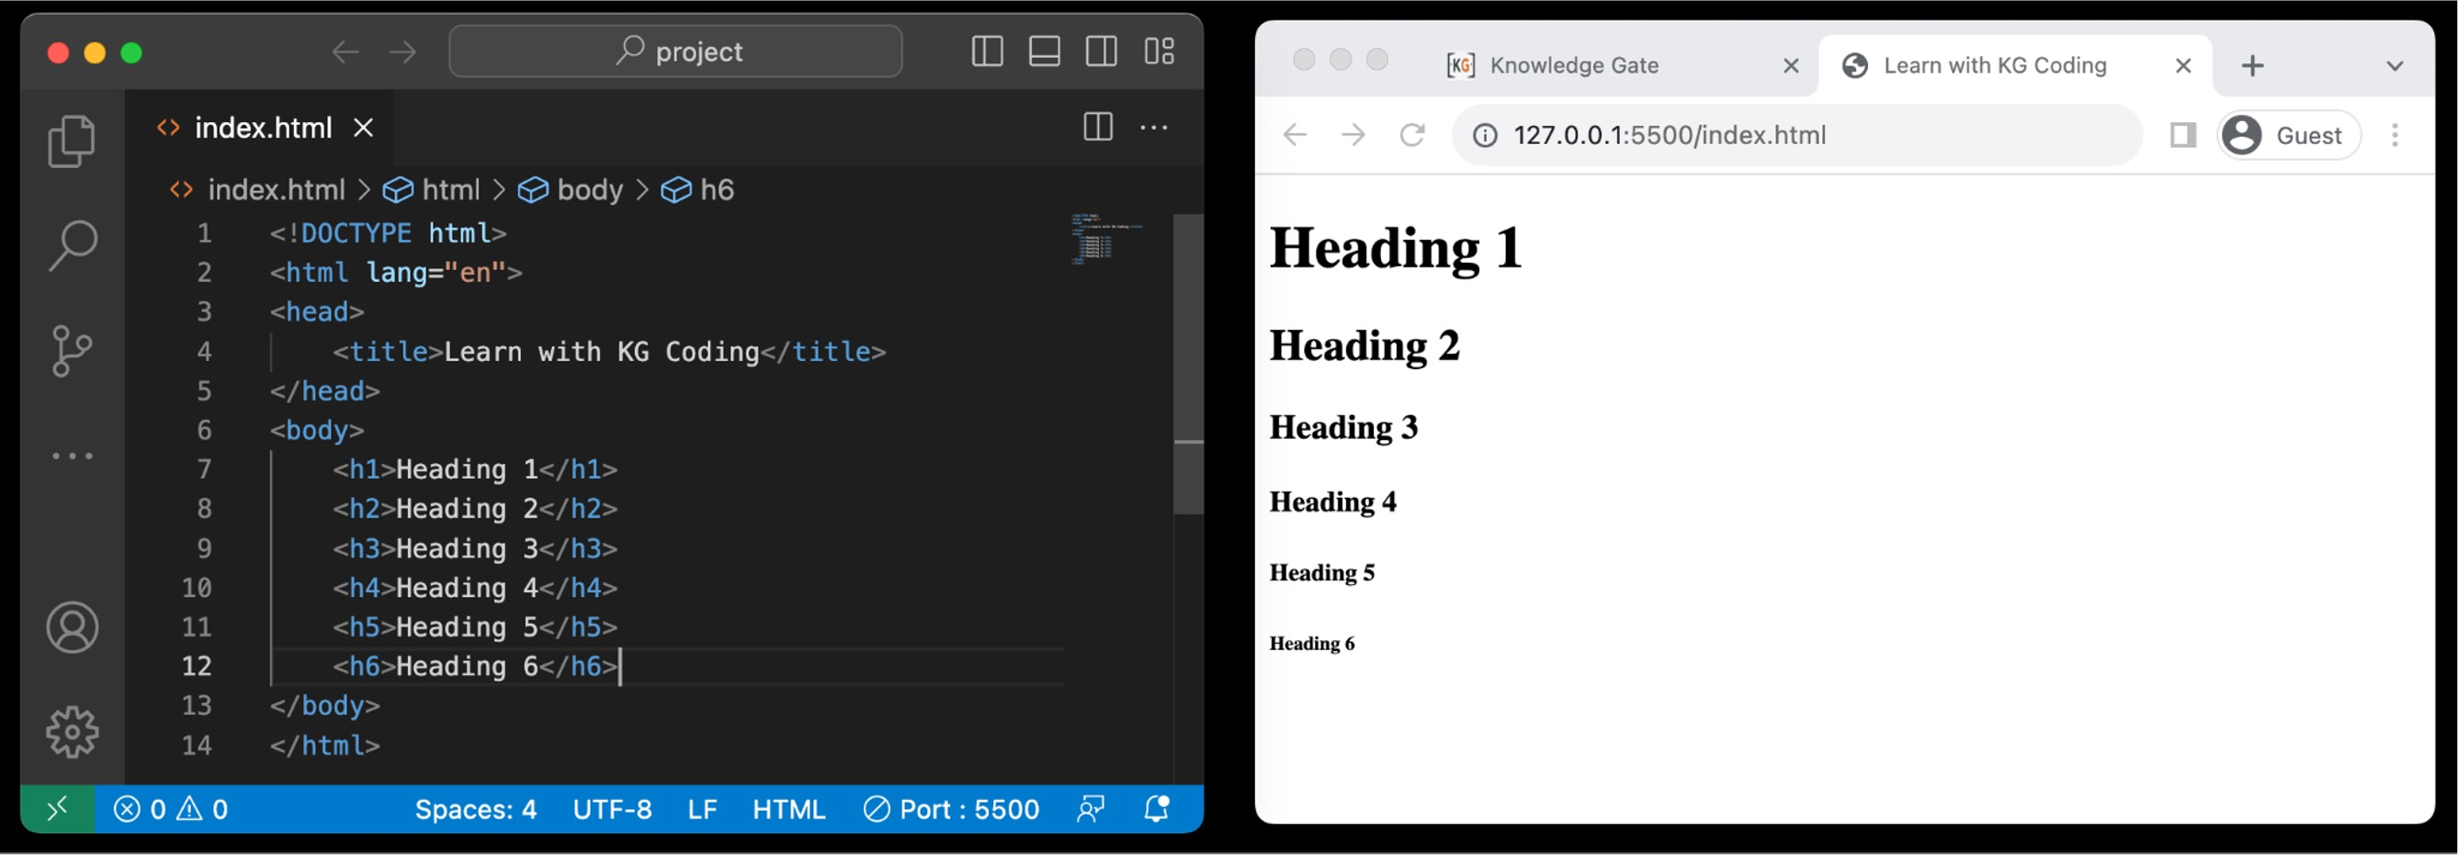
2.1 Heading Tag
Defines headings in a document
Ranges from <h1> to <h6>
<h1> is most important, <h6> is least
Important for SEO
Helps in structuring content

Slide 38
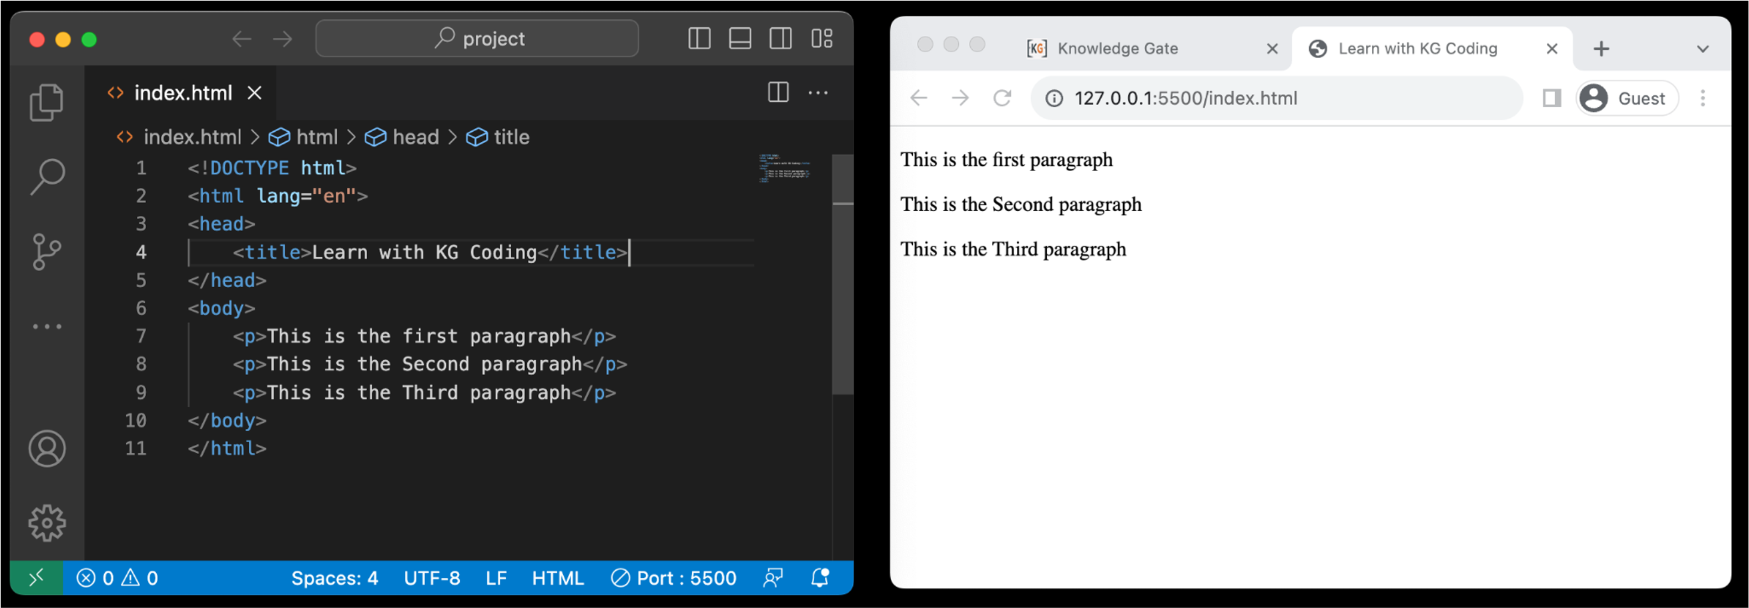
2.2 Paragraph Tag
Used for defining paragraphs
Enclosed within <p> and </p> tags
Adds automatic spacing before and after
Text wraps to next line inside tag
Common in text-heavy content

Slide 39
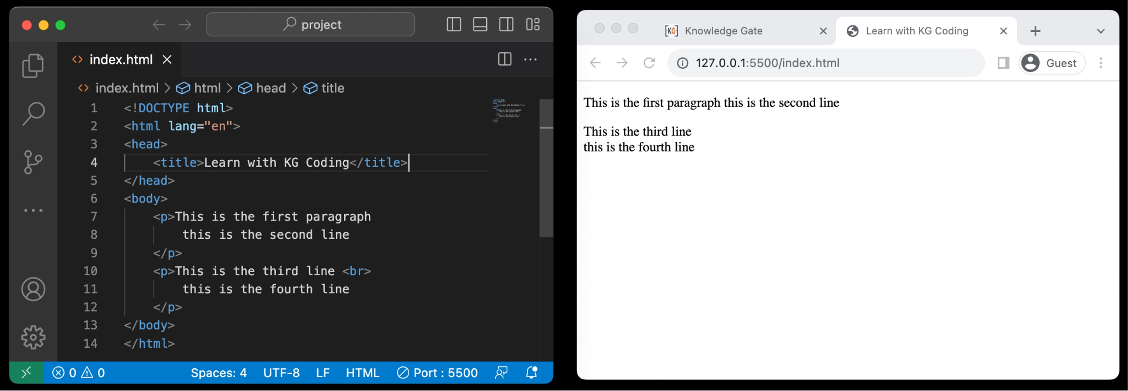
2.3 <BR> Tag
<br> adds a line break within text
<br> is empty, no closing tag needed
<br> and <br /> are both valid

Slide 40
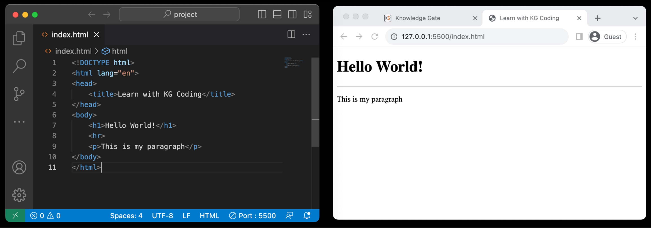
2.3 <HR> Tag
<hr> creates a horizontal rule or line
<hr> also empty, acts as a divider

Slide 41
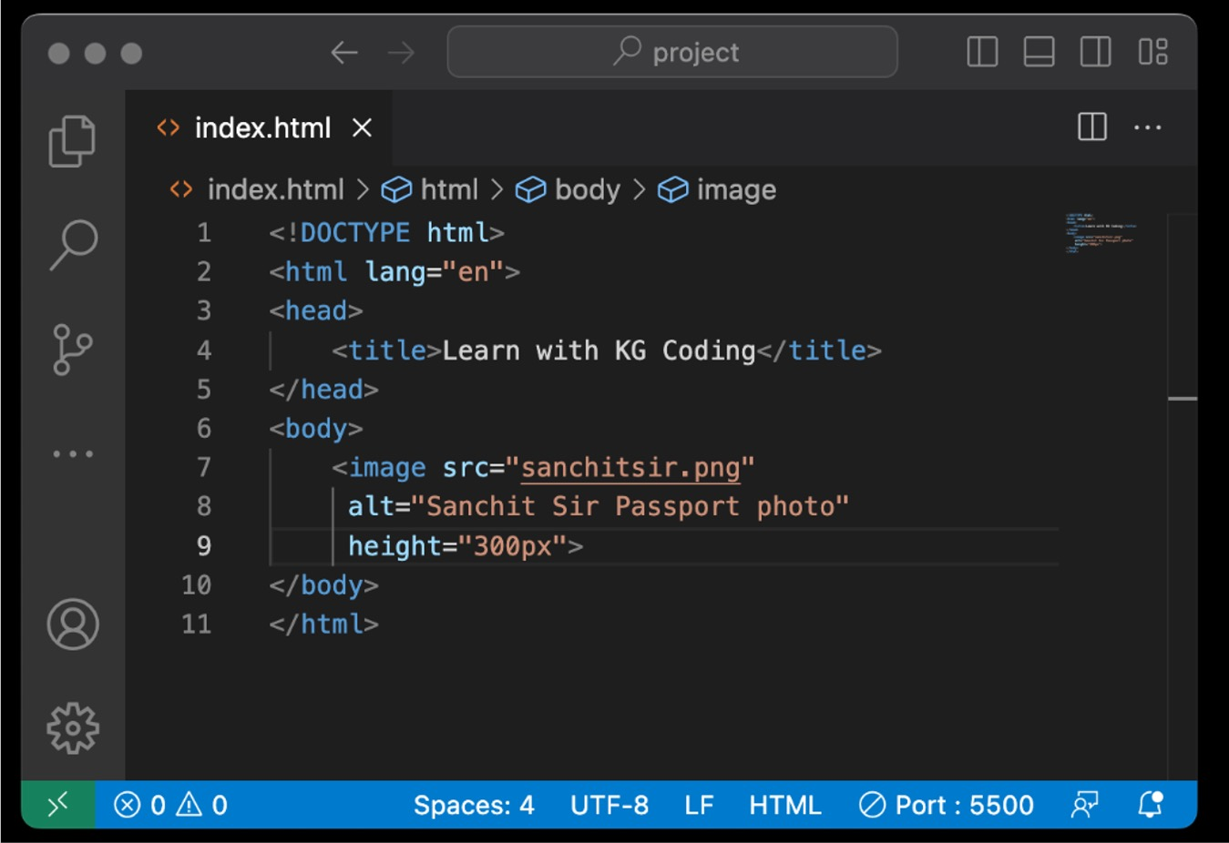
2.4 Image Tag
Used to embed images
Utilizes the src attribute for image URL
alt attribute for alternative text
Can be resized using width and height
Self-closing, doesn't require an end tag

Slide 42
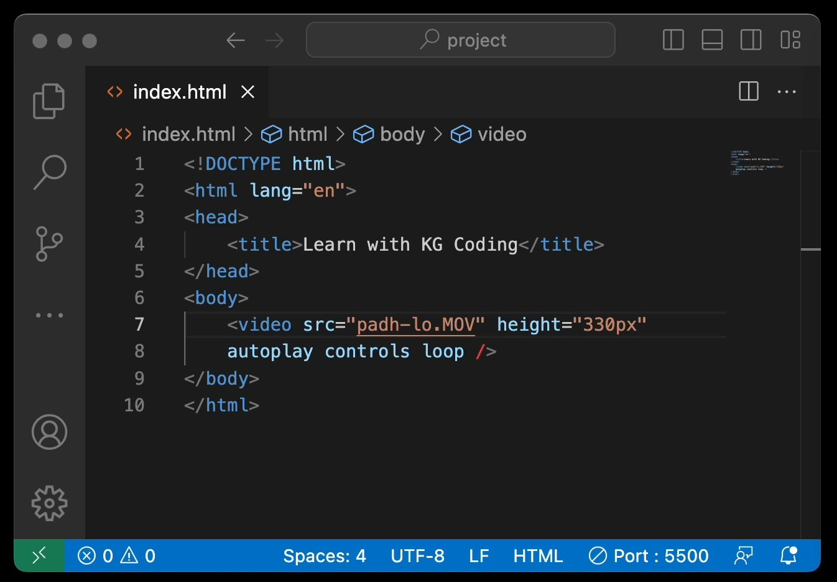
2.5 Video Tag
Embeds video files on a page
Uses src attribute for video URL
Supports multiple formats like MP4, WebM
Allows for built-in controls via attributes like autoplay, controls, loop

Slide 43
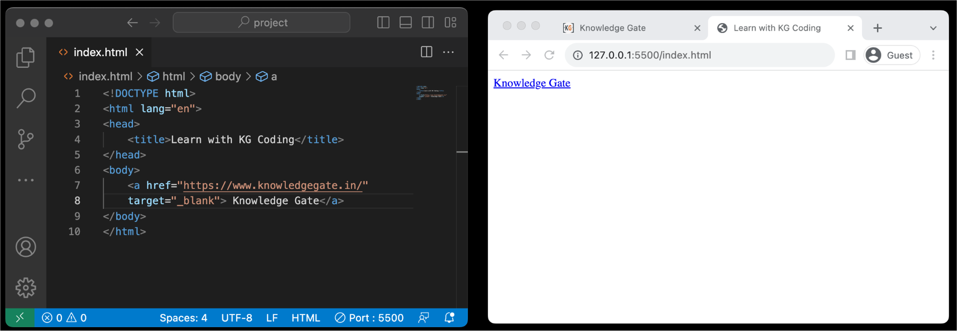
2.6 Anchor Tag
Used for creating hyperlinks
Requires href attribute for URL
Can link to external sites or internal pages
Supports target attribute to control link behavior

Slide 44
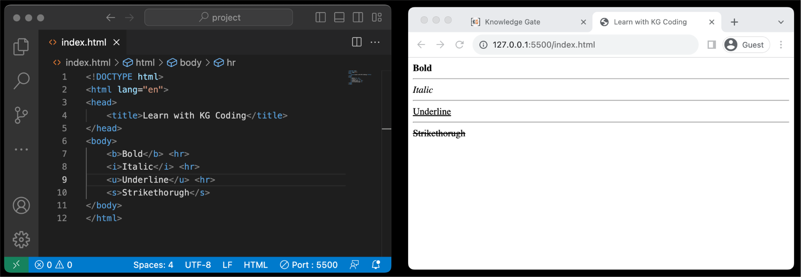
2.7 Bold/Italic/Underline/Strikethrough Tag
<b> makes text bold
<i> makes text italic
<u> underlines text
<s> or <strike> applies strikethrough
Primarily used for text styling and emphasis

Slide 45
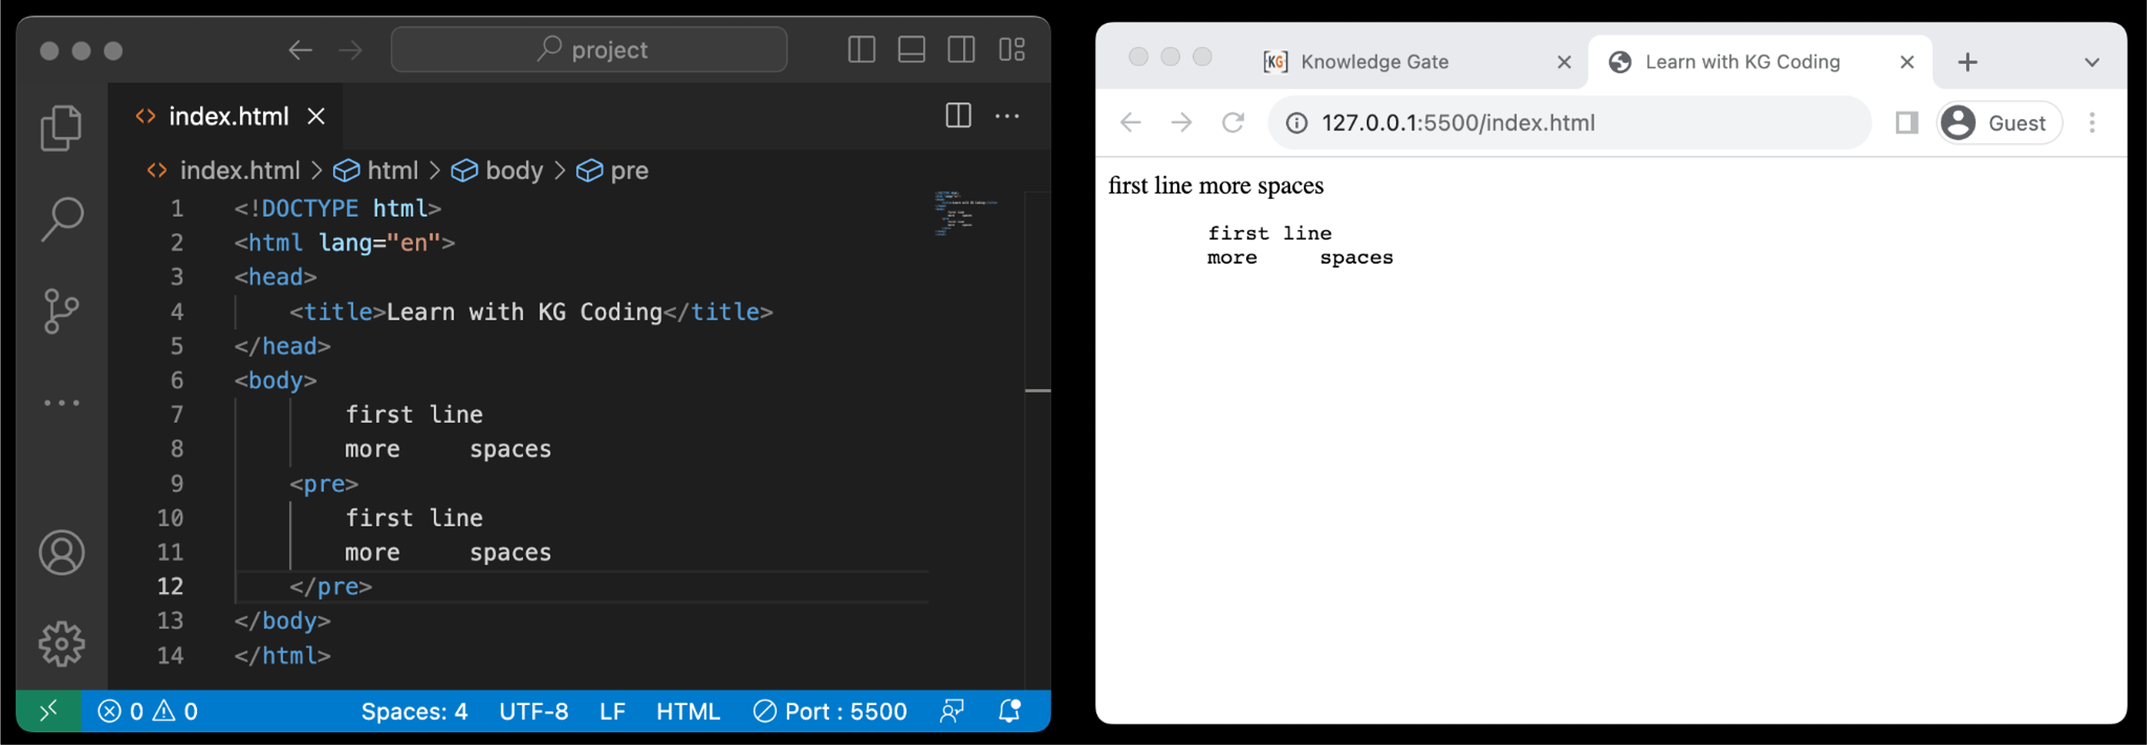
2.8 Pre Tag
Preserves text formatting
Maintains whitespace and line breaks
Useful for displaying code
Enclosed within <pre> and </pre> tags

Slide 46
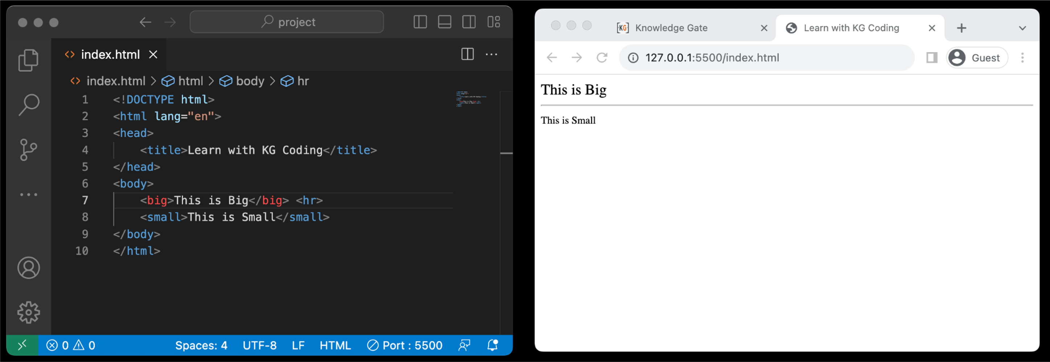
2.9 Big/Small Tag
<big> increases text size
<small> decreases text size
Less common due to CSS alternatives

Slide 47
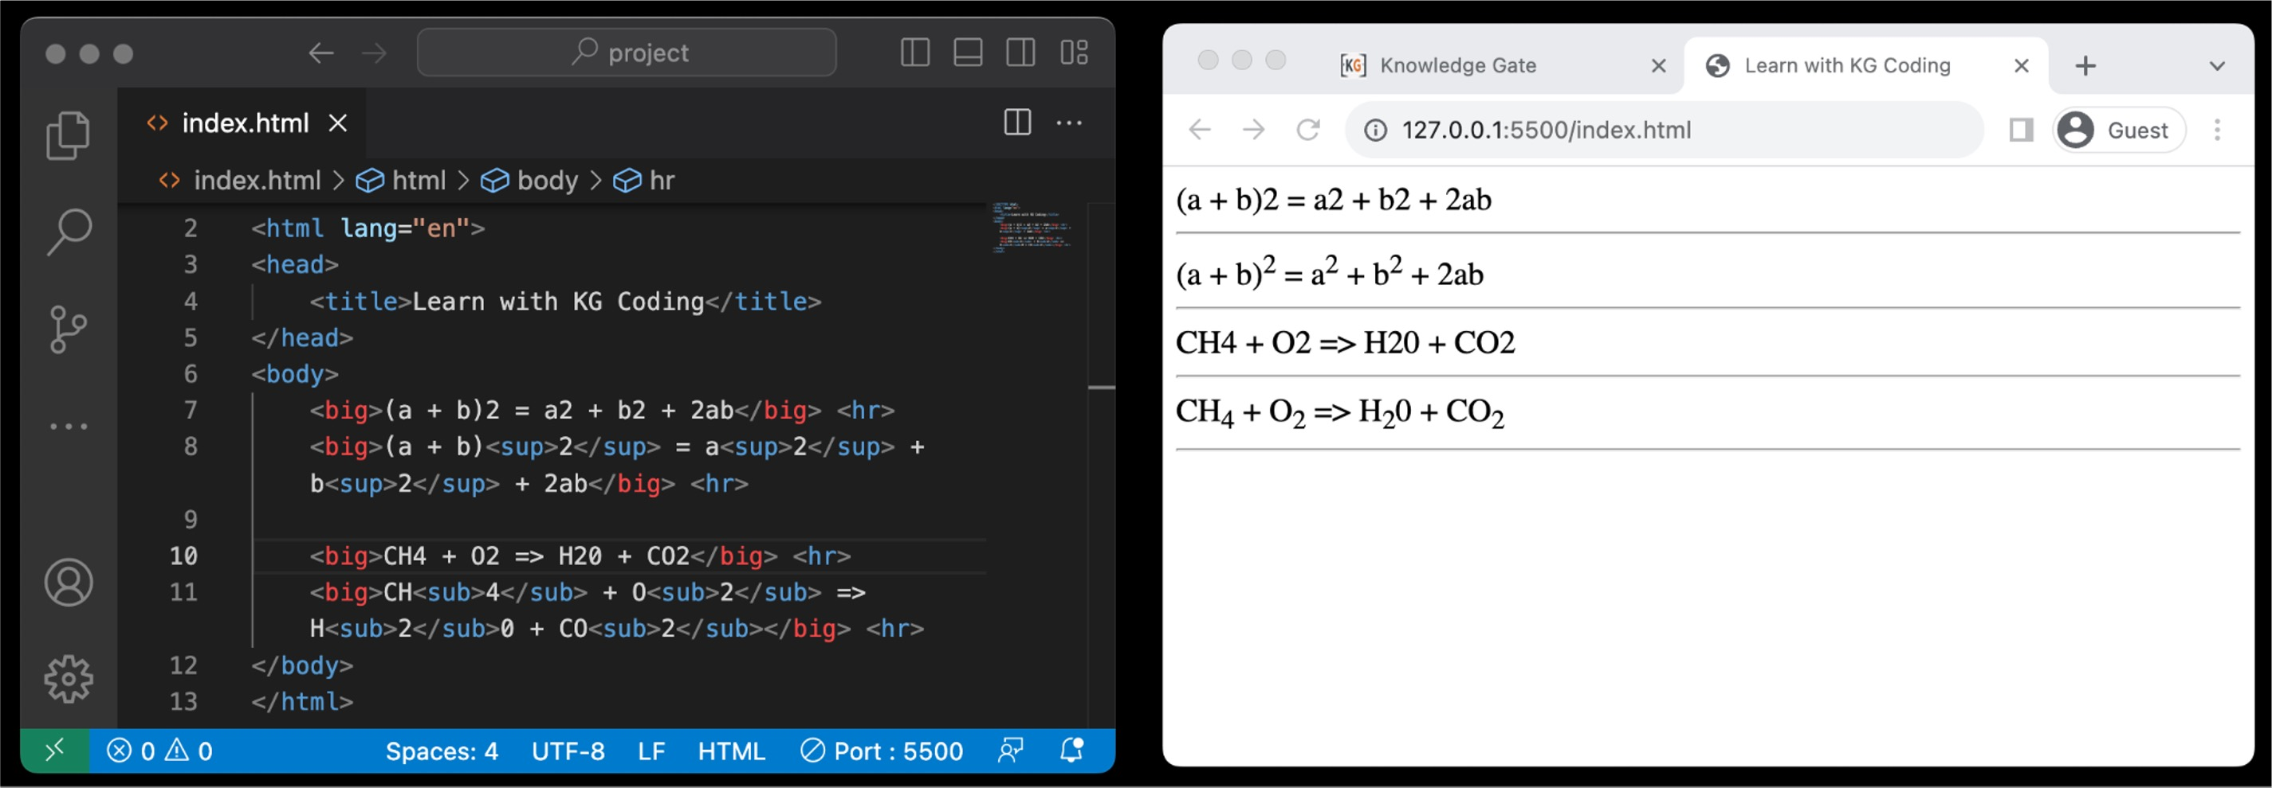
2.10 Superscript/Subscript Tag
<sup> makes text superscript
<sub> makes text subscript
Used for mathematical equations, footnotes
Does not change font size, just position

Slide 48

Level 2
Must-Use HTML Tags
FF5F1F
3.Character Entity
Reference

Slide 49
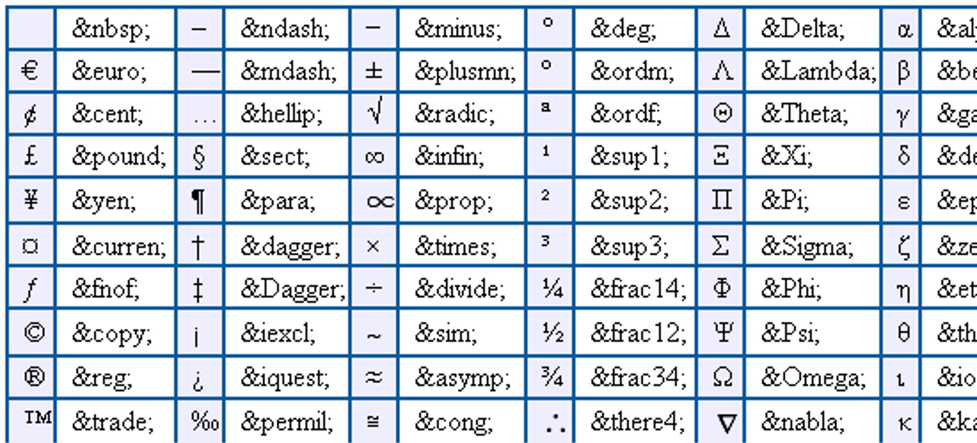
3.1 Character Entity Reference
Used to display reserved or special characters
Syntax often starts with & and ends with ; (e.g., &amp; for &)

Slide 50

Level 2 Revision
Must-Use HTML Tags
HTML Attributes
What are HTML Attributes
Id Property
HTML Tags
Heading Tag
Paragraph Tag
<BR> <HR> tags
Image Tag
Video Tag
Anchor Tag
Bold / Italic / Underline / Strikethrough
Pre Tag
Big / Small Tag
Superscript / Subscript
Character Entity Reference
What are Character Entity References

Slide 51
Project Level 2
Must-Use HTML Tags
Create a page with heading, paragraph, line breaks and separators.
Use an image with height 300, which is a link to another page.
Use bold, italic, underline and strike through in one line.
Write third equation of motion using superscript and subscript.

Slide 52
Level 3
Browser Tools
Browser Tools
View Page Source
Inspect Element
HTML without CSS
Responsive Design
Different screen size
Live Edit Code
Live edit HTML
Live edit CSS
Live edit JS
Changes only happening at client
Validating Web pages
Using validator.w3.org

Slide 53

Level 3
Browser Tools
1. Browser Tools

Slide 54
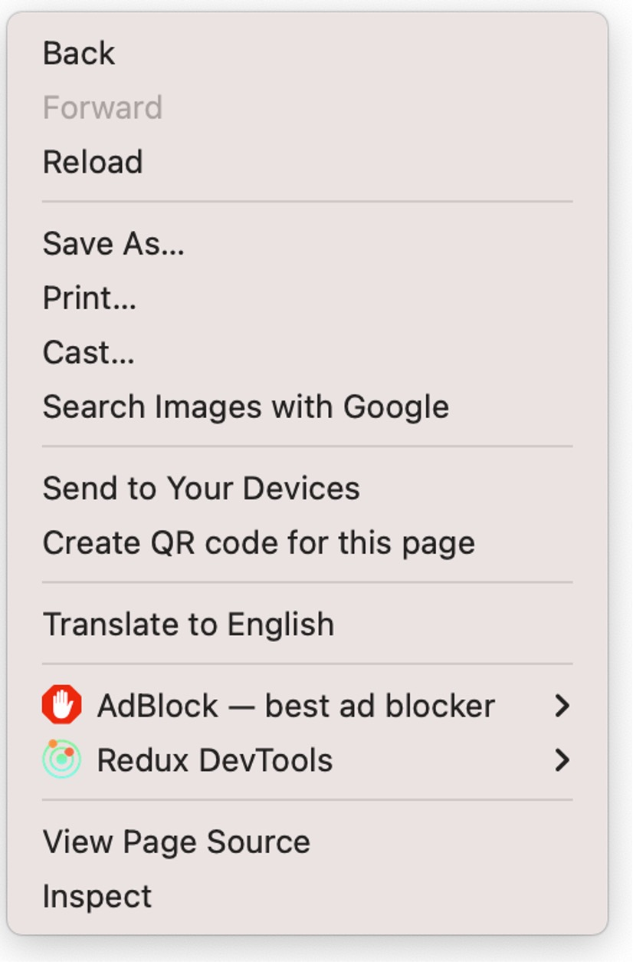
1.1 View Page Source
Displays raw HTML and CSS
Useful for debugging and learning
Shows external files like JavaScript links

Slide 55
1.2 Inspect Element
Allows real-time editing of HTML/CSS
Useful for debugging and testing
Shows element hierarchy and layout
Includes console for JavaScript
Highlights selected elements on page

Slide 56

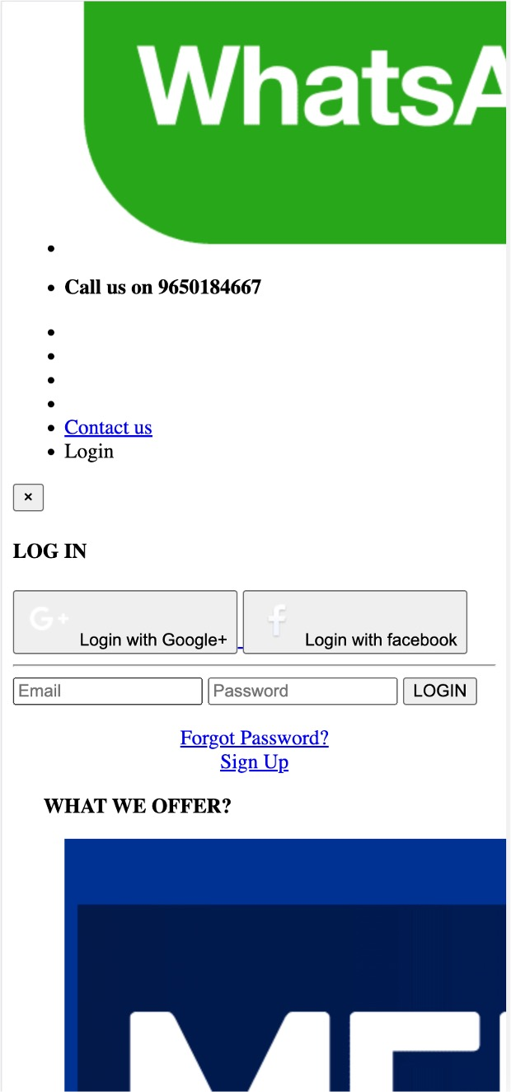
1.3 HTML without CSS

Slide 57
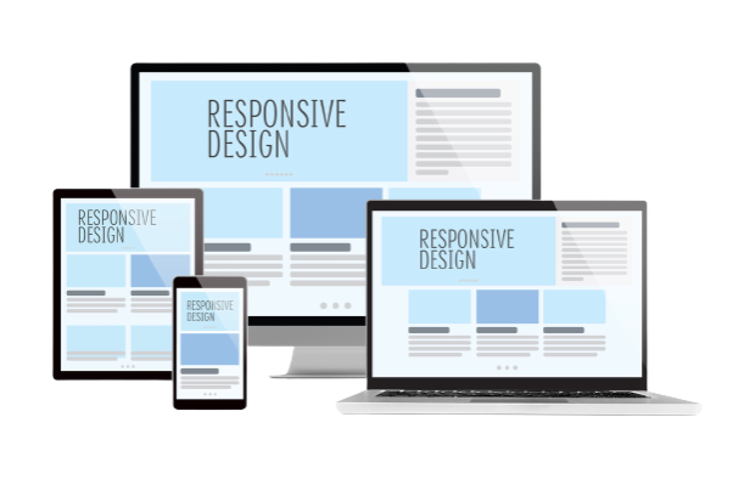
Level 3
Browser Tools
2.
Responsive Design

Slide 58
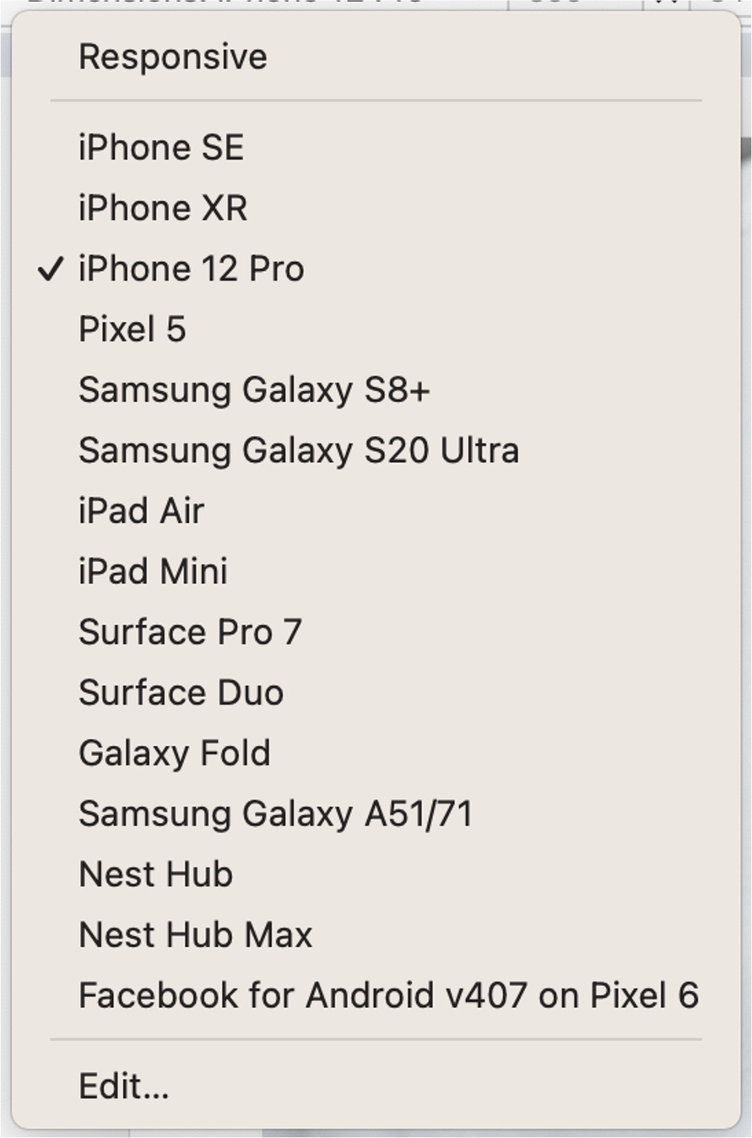
2.1 Different Screen Sizes
Adapts layout for different screen sizes
Flexible layouts
Optimizes images and assets
Enhances user experience on mobile and desktop

Slide 59

3.4 Changes happening at Client
Changes made are temporary
Affect only the current session
Not saved to the server
Reset upon page reload
Useful for testing, not permanent fixes
Like: If you change the question in your question paper that has no effect on actual exam.

Slide 60

Level 3
Browser Tools
4. Validating WebPages

Slide 61
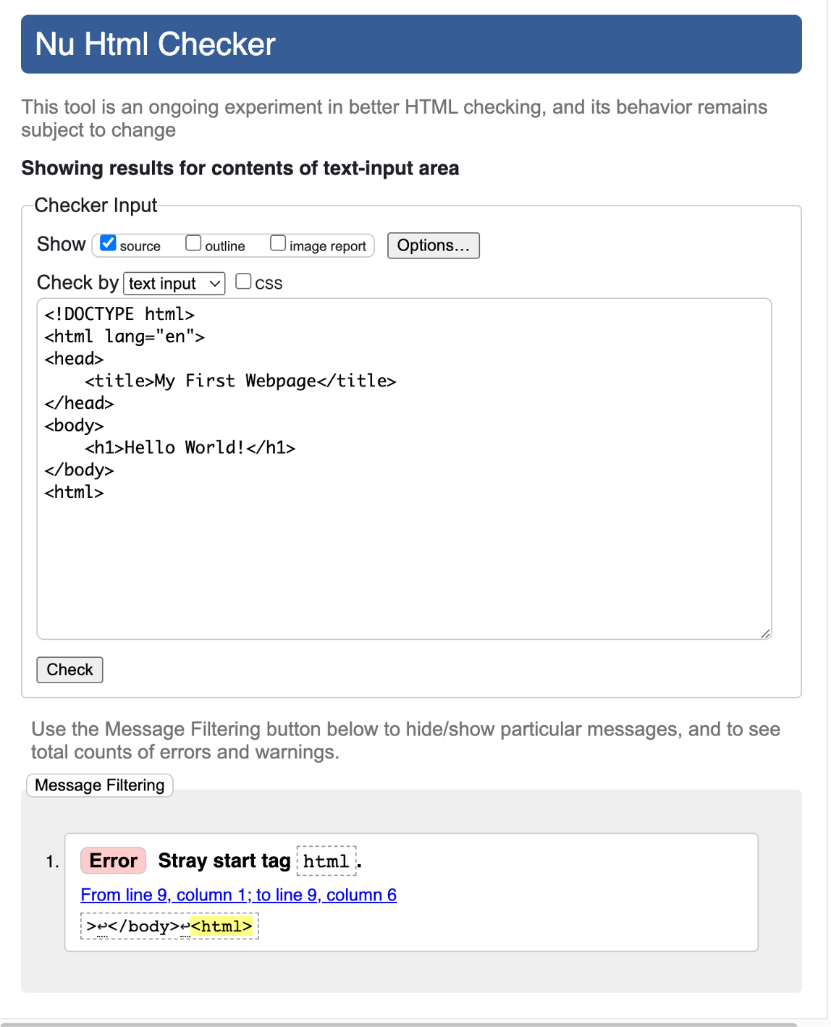
4.1 Using validator.w3.org
Ensures HTML adheres to standards
Minimizes cross-browser issues
Helps in achieving better SEO results
Easier to debug and maintain
Optimizes performance by reducing parsing errors

Slide 62
Level 3 Revision
Browser Tools
Browser Tools
View Page Source
Inspect Element
HTML without CSS
Responsive Design
Different screen size
Live Edit Code
Live edit HTML
Live edit CSS
Live edit JS
Changes only happening at client
Validating Web pages
Using validator.w3.org

Slide 63
Project Level 3
Browser Tools
Save Source of Instagram in a file and check the render.
Inspect the likes element on the page and read the code to understand.
Change number of likes on Your Instagram post
Validate the page we created in last project.

Slide 64
Level 4
HTML and Project Structure
Semantic Tags
Semantic / Non-Semantic Tags
Body Tags
Header Tag
Main Tag
Section Tag
Article Tag
Aside Tag
Footer Tag
Folder Structure
Recommended Folder structure
More Tags
Navigation tags
Block / Inline Elements
Div tags
Span Tags

Slide 65
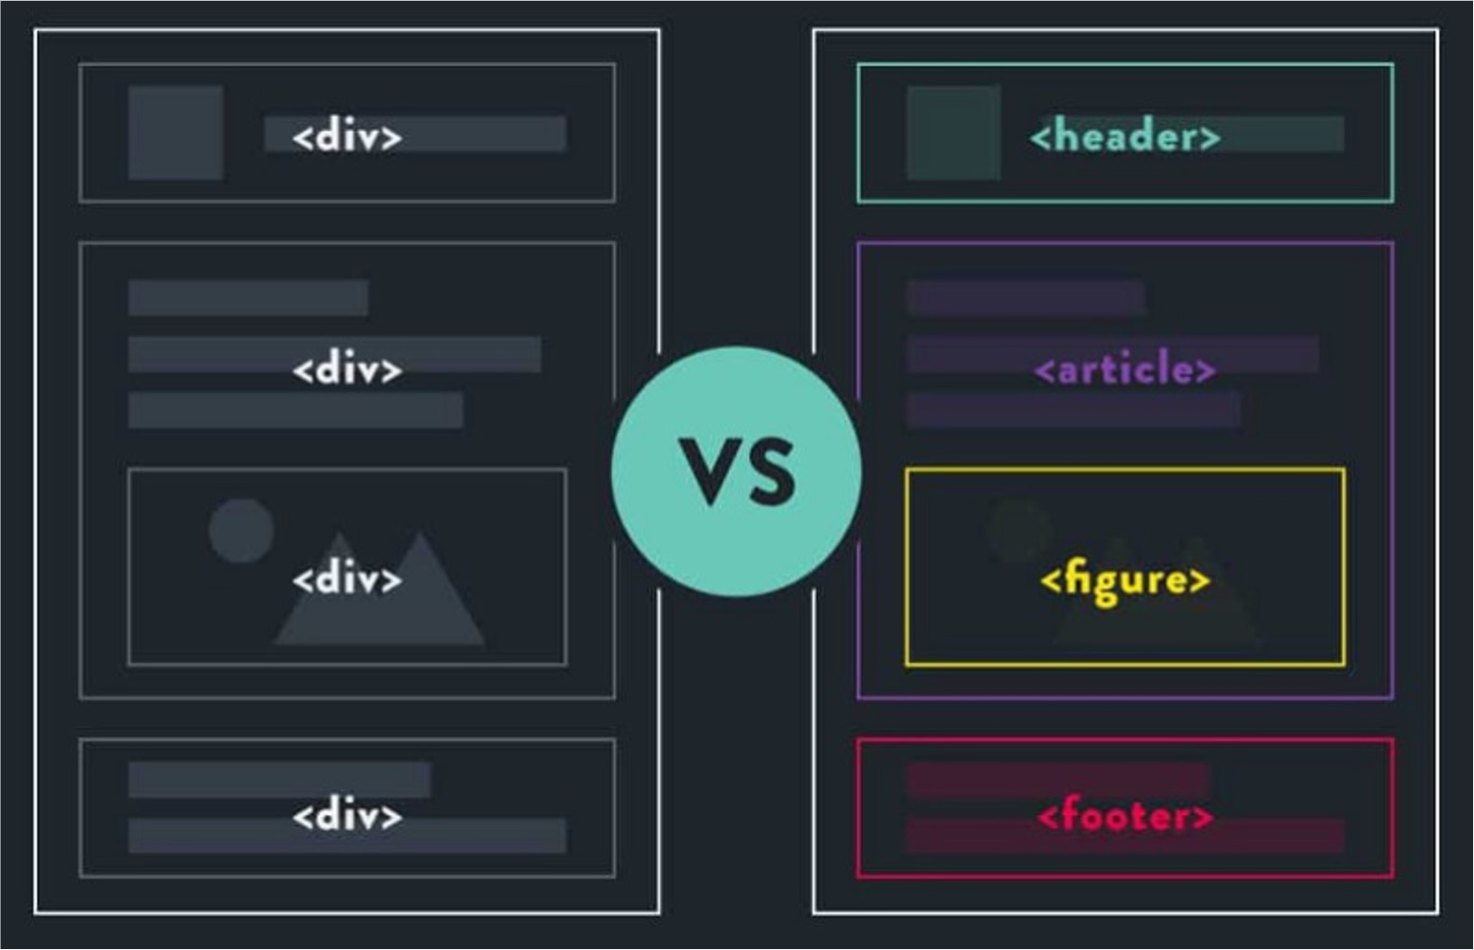
Level 4
HTML and Project Structure
1. Semantic Tags

Slide 66
1.1 Semantic/Non-Semantic Tags
Semantic Tags
Non-Semantic Tags
Meaningful: Describe content.
SEO: Good for search engines.
Accessibility: Useful for screen readers.
Examples: <header>, <footer>,
<article>, <section>, <nav>.
Generic: No specific meaning.
For Styling: Used for layout.
No SEO: Not SEO-friendly.
Examples: <div>, <span>, <i>,
<b>.

Slide 67
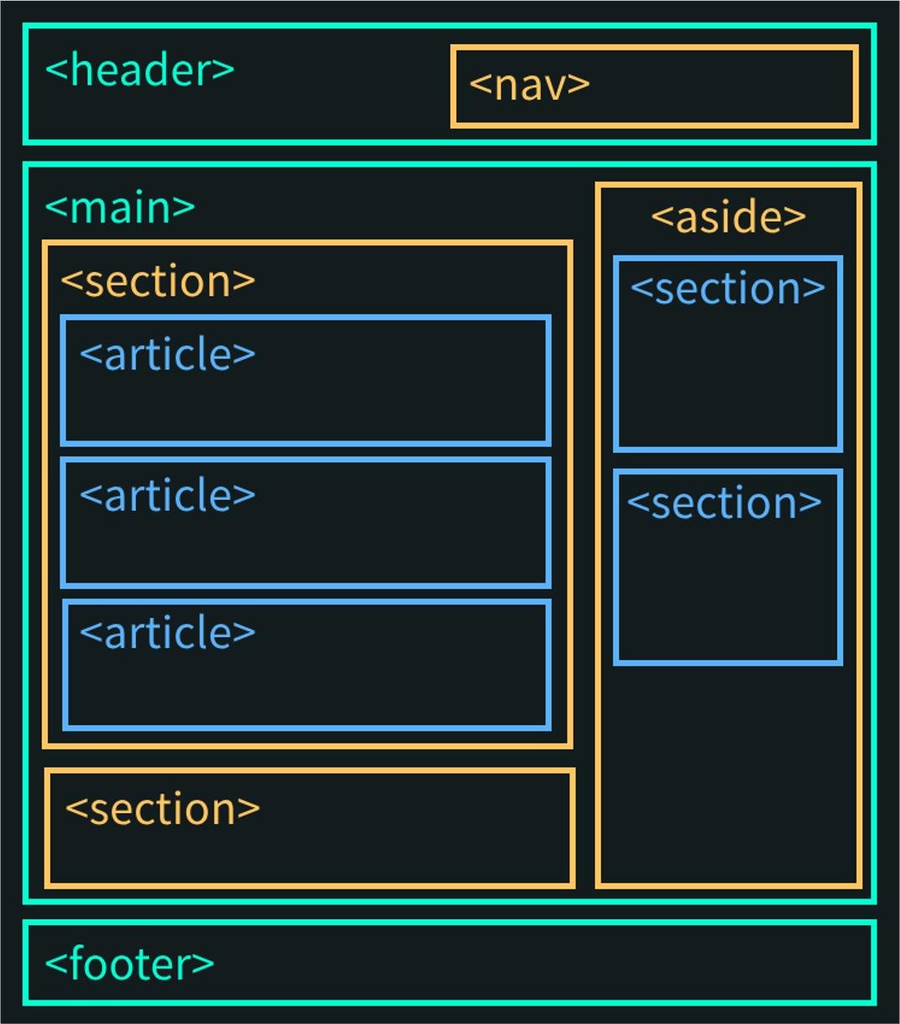
Level 4
HTML and Project Structure
2. Body Tags

Slide 68
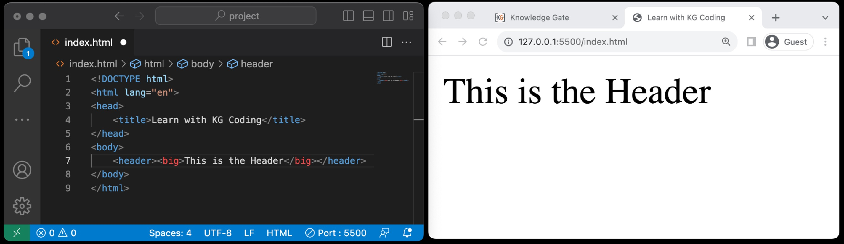
2.1 Header Tag
Purpose: Used to contain introductory content or navigation links.
Semantic: It's a semantic tag, providing meaning to the enclosed content.
Location: Commonly found at the top of web pages, but can also appear within
<article> or <section> tags.
Multiple Instances: Can be used more than once on a page within different sections.

Slide 69
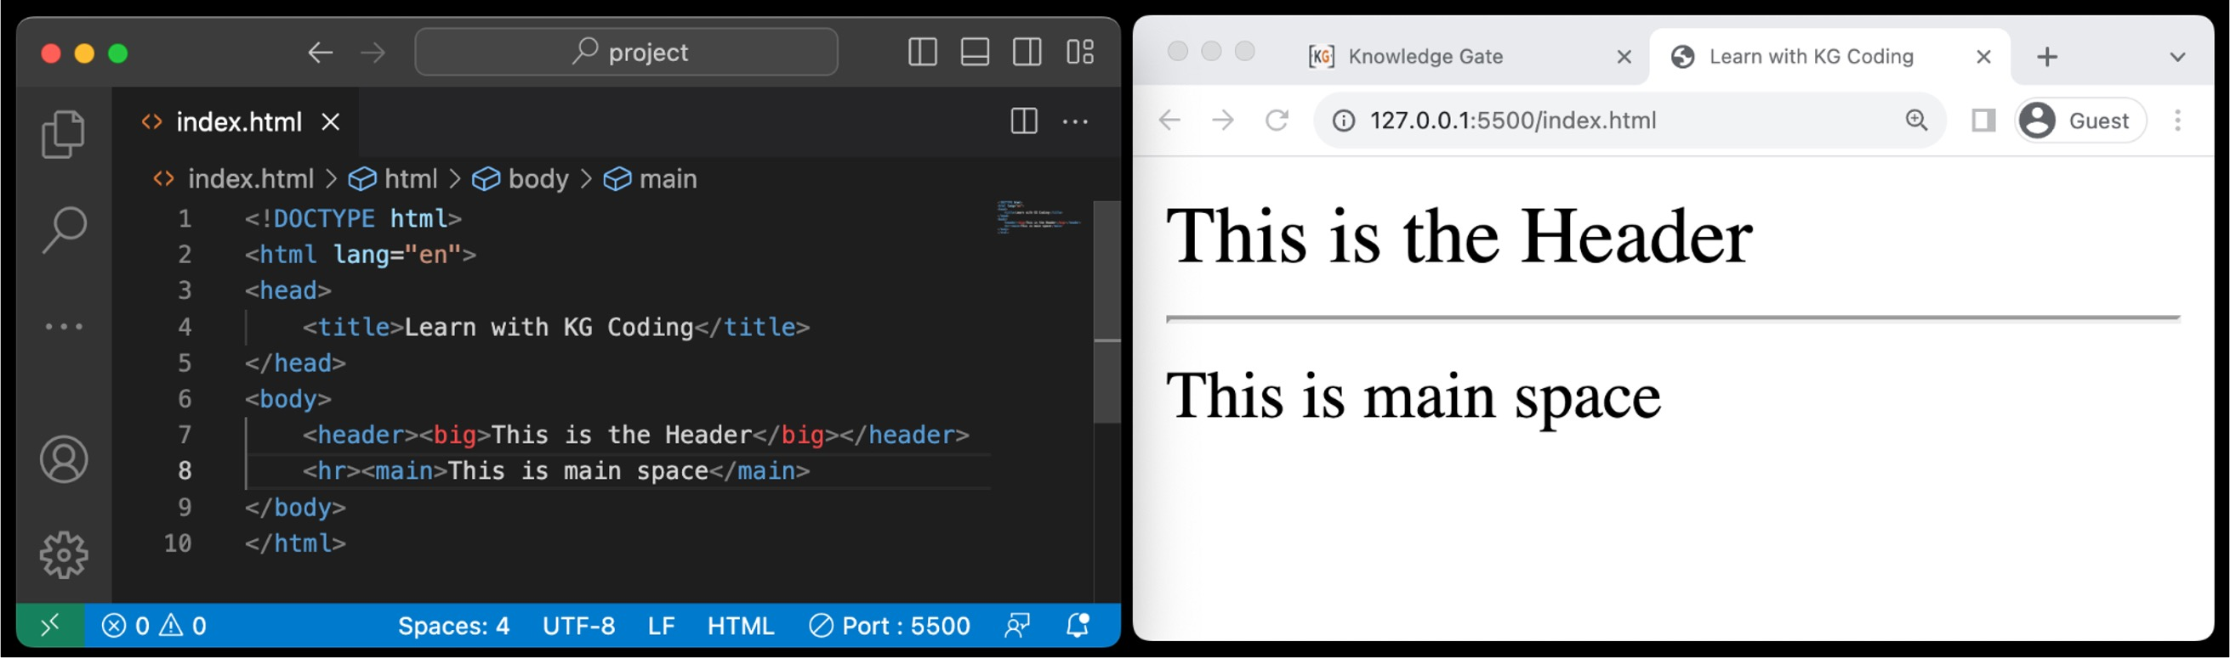
2.2 Main Tag
Purpose: Encloses the primary content of a webpage.
Semantic: Adds meaning, indicating the main content area.
Unique: Should appear only once per page.
Accessibility: Helps screen readers identify key content.
Not for Sidebars: Excludes content repeated across multiple pages like site navigation or footer.

Slide 70
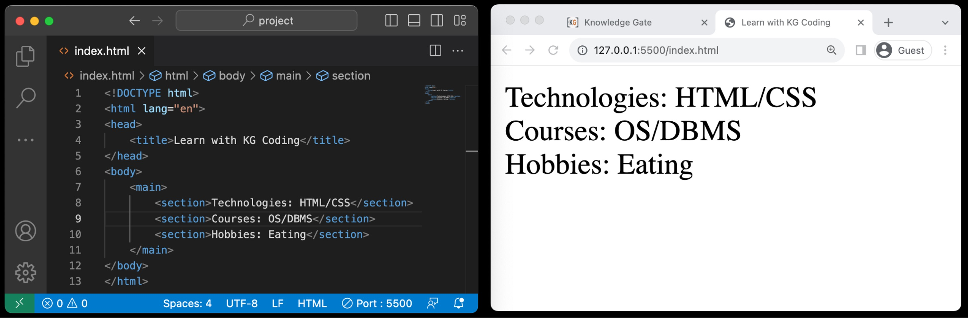
2.2.1 Section Tag
Purpose: Groups related content in a distinct section.
Semantic: Adds structure and meaning.
Headers: Often used with a heading <h1> to <h6> to indicate section topic.
Nested: Can be nested within other <section> or <article> tags.

Slide 71
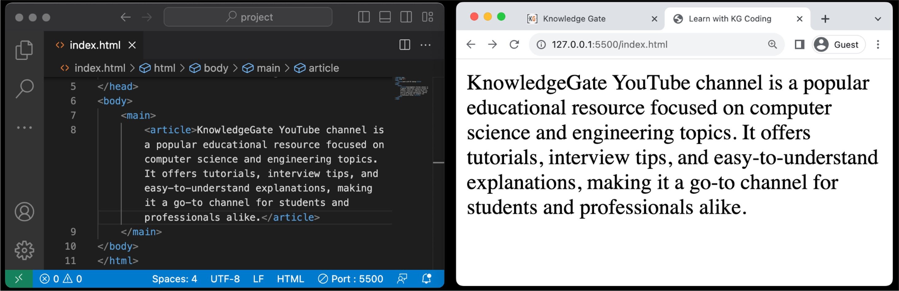
2.2.2 Article Tag
Purpose: Encloses content that stands alone, like a blog post or news story.
Semantic: Provides contextual meaning.
Independence: Content should make sense even if taken out of the page context.
Multiple Instances: Can be used multiple times on the same page

Slide 72
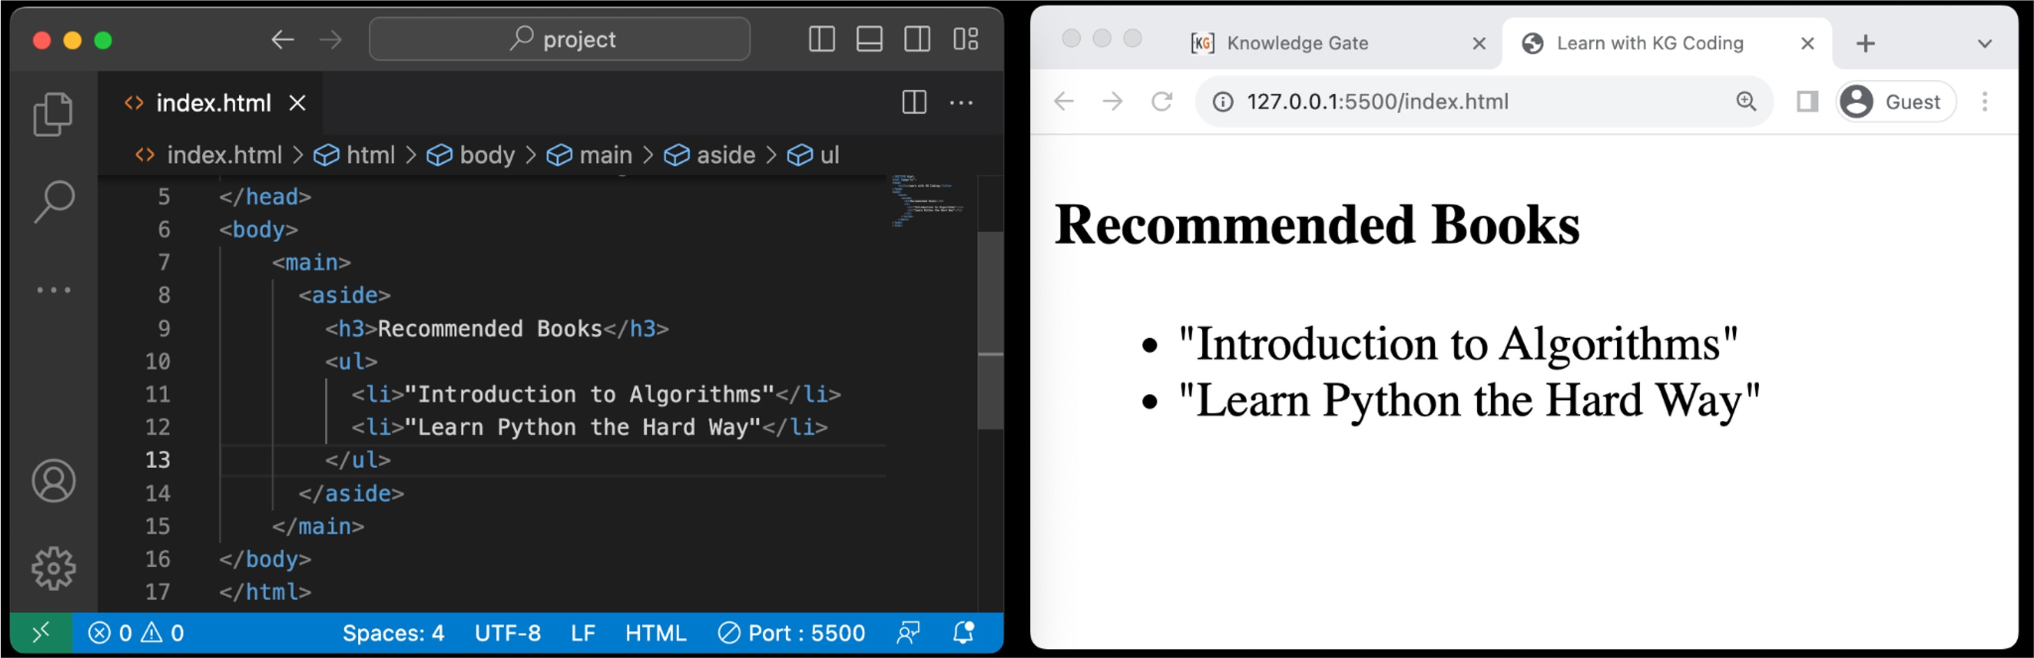
2.2.3 Aside Tag
Purpose: Contains sidebar or supplementary content.
Semantic: Indicates content tangentially related to the main content.
Not Crucial: Content is not essential to understanding the main content.
Examples: Could hold widgets, quotes, or ads.

Slide 73
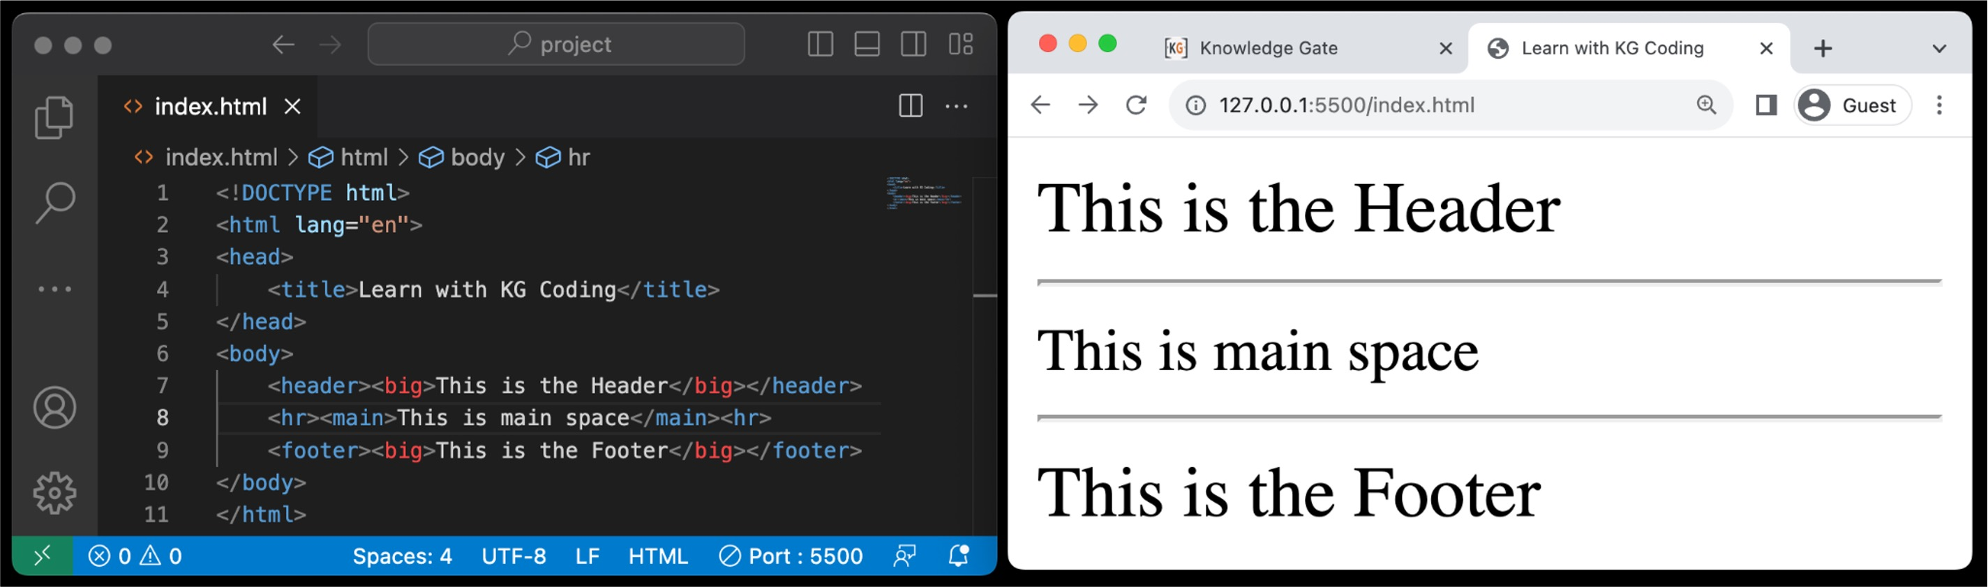
2.3 Footer Tag
Purpose: For footer content like extra info or links.
Semantic: Provides meaning to enclosed content.
Location: Typically at the bottom of pages or sections.
Content: Includes copyrights, contact info, and social links.
Multiple Instances: Can be used more than once on a page.

Slide 74

Level 4
HTML and Project Structure
3. Folder Structure

Slide 75
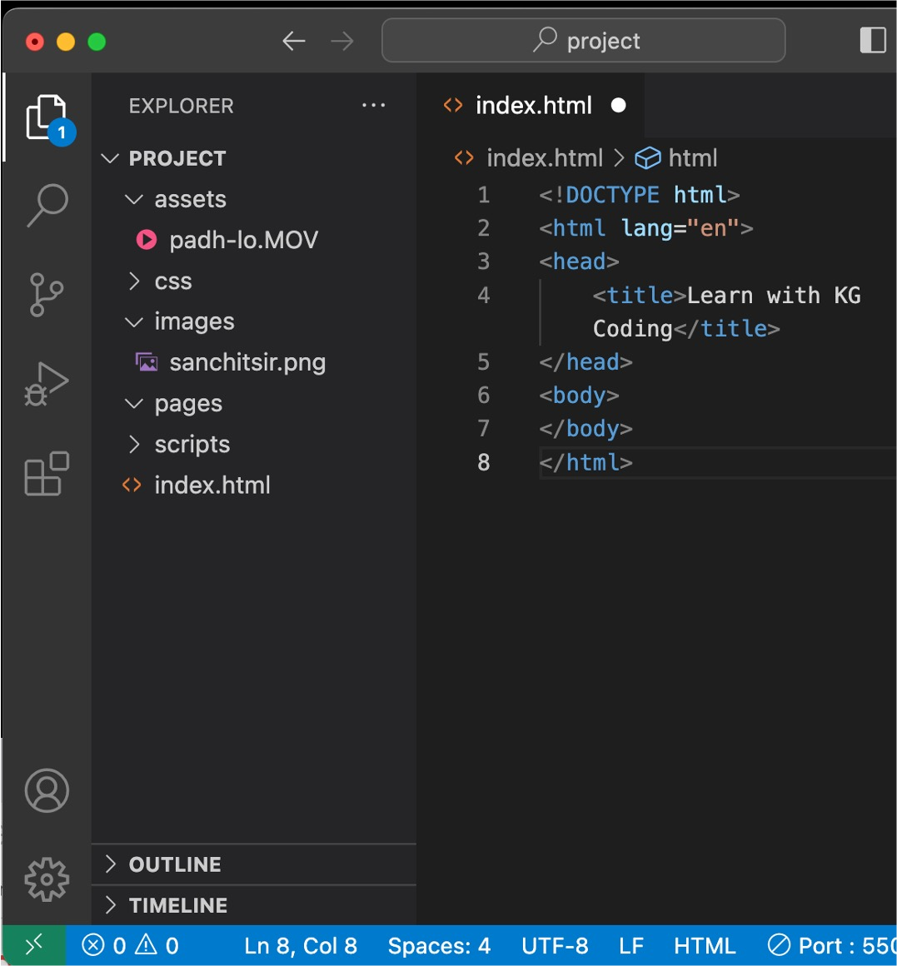
3.1 Recommended Folder Structure
Root Directory: Main folder containing all website files.
HTML Files: Store main .html files at the root level for easy access.
CSS Folder: Create a css/ folder for all Cascading Style Sheets.
JS Folder: Use a scripts/ folder for JavaScript files.
Images Folder: Store images in an images/ or images/ folder.
Assets: Other assets like fonts can go in an assets/ folder.
Sub-directories: For multi-page websites, use sub-folders to categorize content.

Slide 76
Level 4
HTML and Project Structure
4. More Tags

Slide 77
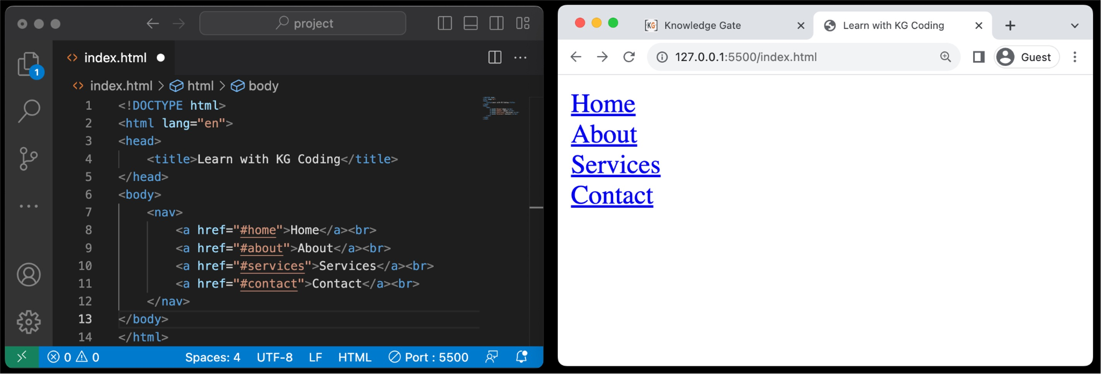
4.1 Navigation Tags
Purpose: Encloses navigation links or menus.
Semantic: Signals that the content is meant for navigating the site.
Common Content: Usually contains lists <ul>, <ol> of links <a>.
Accessibility: Aids screen readers in identifying site navigation.

Slide 78
4.2 Block / Inline Elements
Block Elements
Inline Elements
New Line: Start on a new line.
Full Width: Take up all horizontal space.
Styling: Can have margins and
padding.
Size: Width and height can be set.
Examples: <div>, <p>, <h1>,
<ul>, <li>.
Flow: Stay in line with text.
Width: Just as wide as the content.
No Break: No new line between elements.
Limited Styling: Can't set size easily.
Examples: <span>, <a>, <strong>,
<em>, <img>.

Slide 79
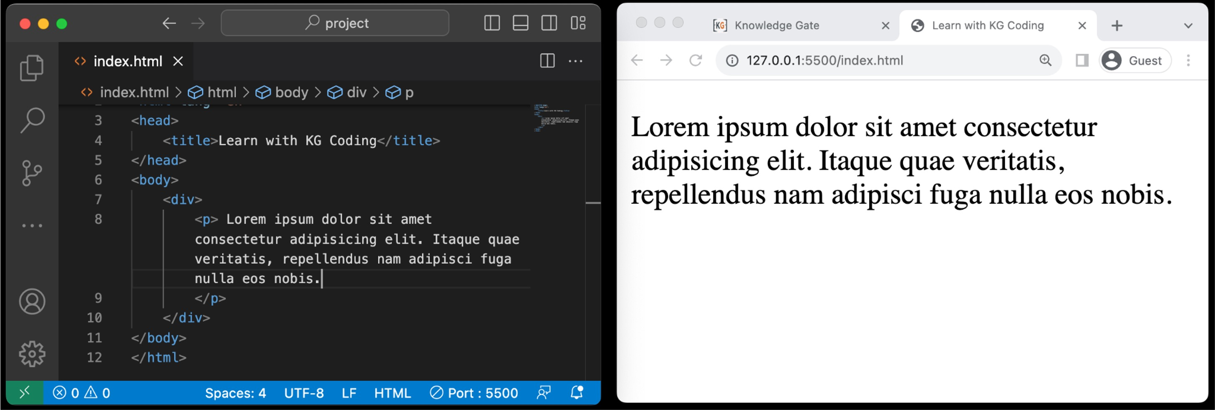
4.3 Div Tags
Purpose: Acts as a container for other HTML elements.
Non-Semantic: Doesn't provide inherent meaning to enclosed content.
Styling: Commonly used for layout and styling via CSS.
Flexibility: Highly versatile and can be customized using classes or IDs.

Slide 80
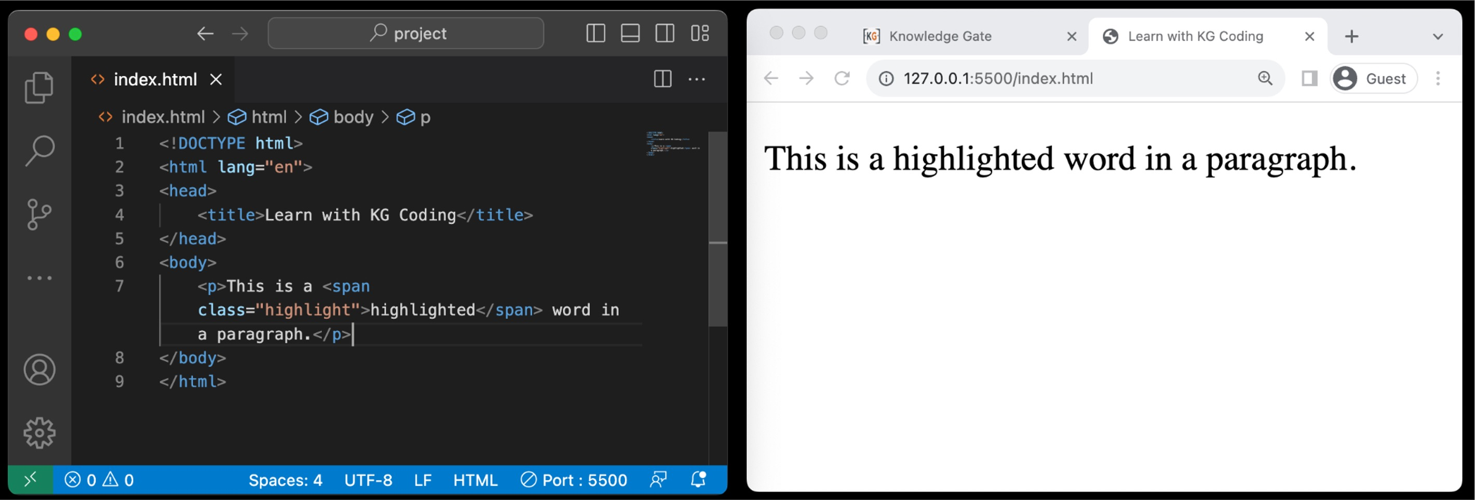
4.4 Span Tags
Purpose: Used for inline elements to style or manipulate a portion of text.
Non-Semantic: Doesn't add specific meaning to the enclosed text.
Styling: Commonly used for changing color, font, or adding effects via CSS.
Inline Nature: Doesn't break text flow or create a new block-level element.

Slide 81
Level 4 Revision
HTML and Project Structure
Semantic Tags
Semantic / Non-Semantic Tags
Body Tags
Header Tag
Main Tag
Section Tag
Article Tag
Aside Tag
Footer Tag
Folder Structure
Recommended Folder structure
More Tags
Navigation tags
Block / Inline Elements
Div tags
Span Tags

Slide 82
Project Level 4
HTML and Project Structure
Create a page with header, footer, main(section, article, aside tag).
Make sure the project from level 3 has correct folder structure.
Create groupings of multiple tags using div.
Create navigation to important sections of your page.

Slide 83
Level 5
List, Tables & Forms
List Tag
Ordered Lists
Types of Ordered Lists
Unordered Lists
Table Tag
<tr>, <td>, <th> tags
Captions
Col spans
Forms
Input tag
Action Attributes
Name and Value Property
Label Tag
Exploring Types
iFrame Tag
Using iFrames

Slide 84
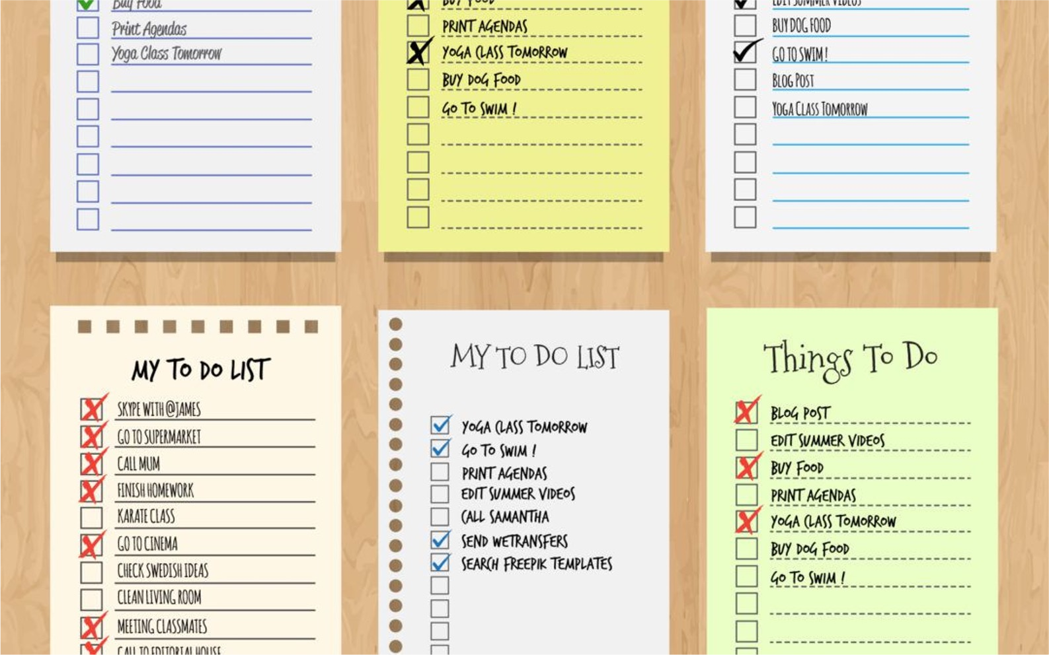
Level 5
List, Tables & Forms
1. List Tag

Slide 85
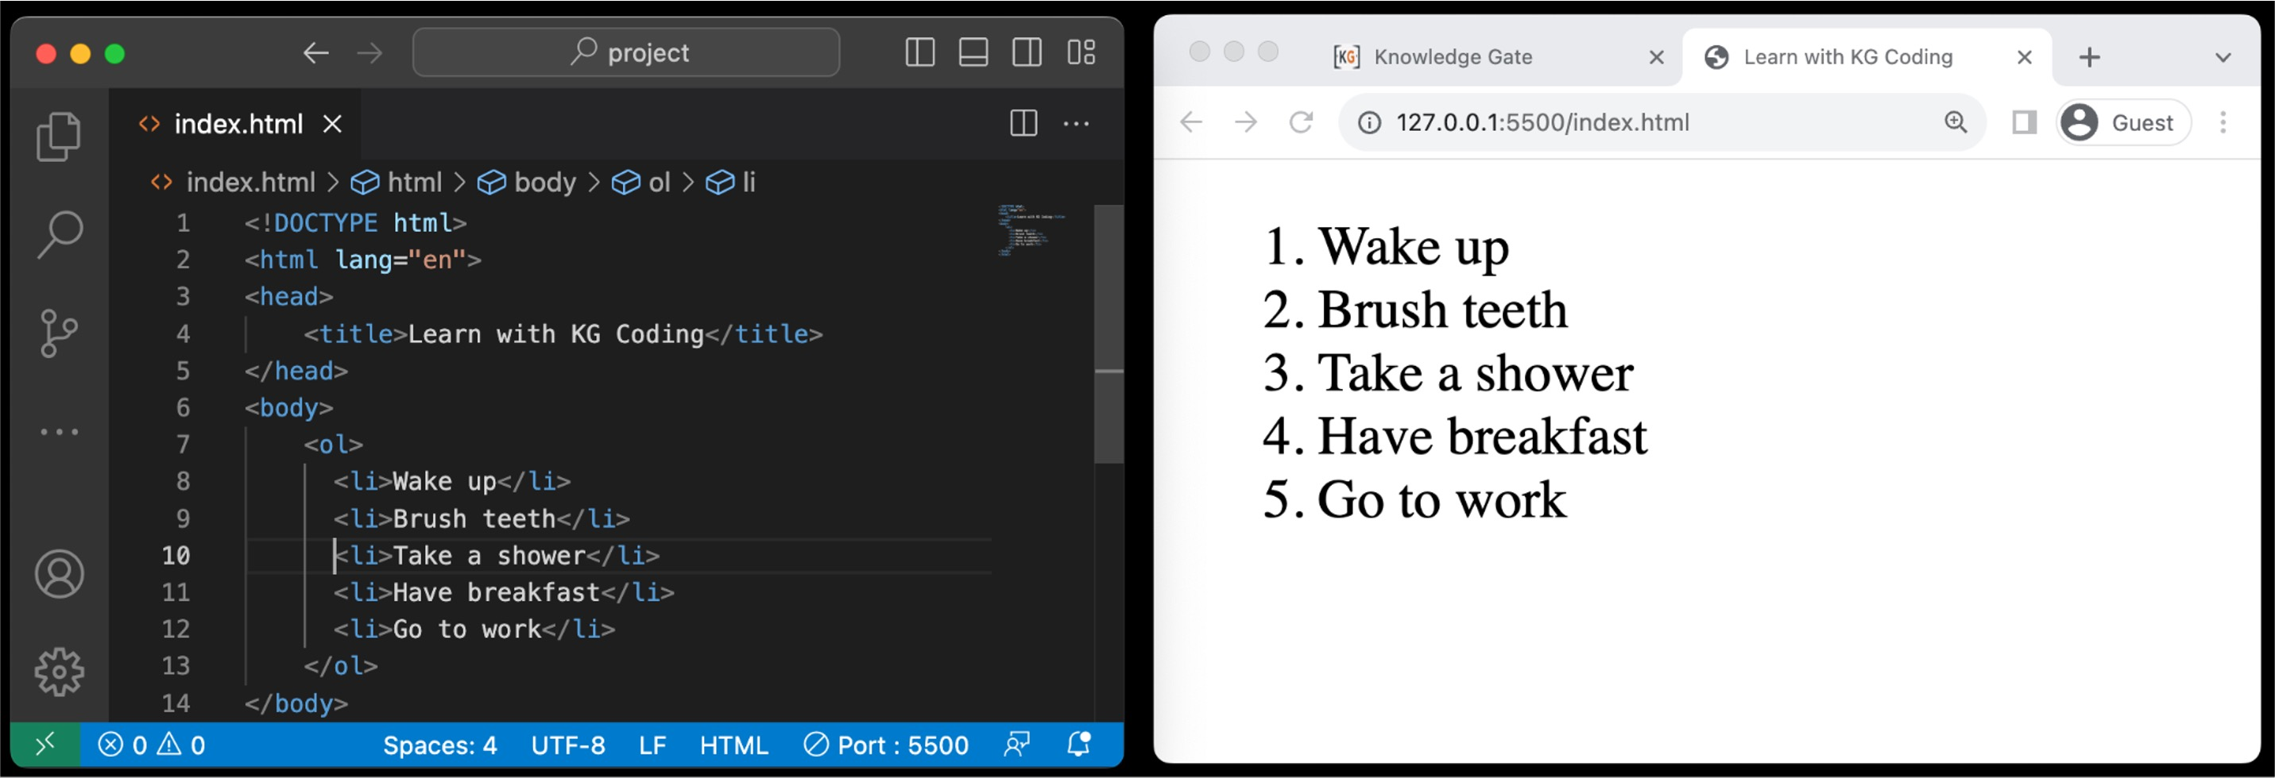
1.1 Ordered Lists
Purpose: Used for creating lists with items that have a specific order.
Default: Items are automatically numbered.
Nesting: Can be nested within other lists.

Slide 86
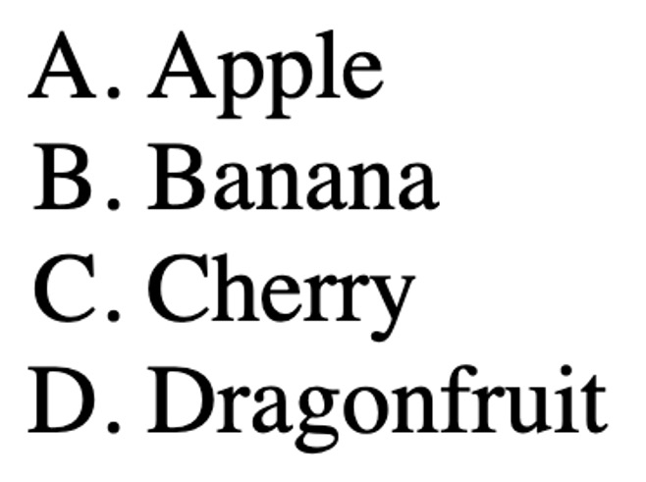
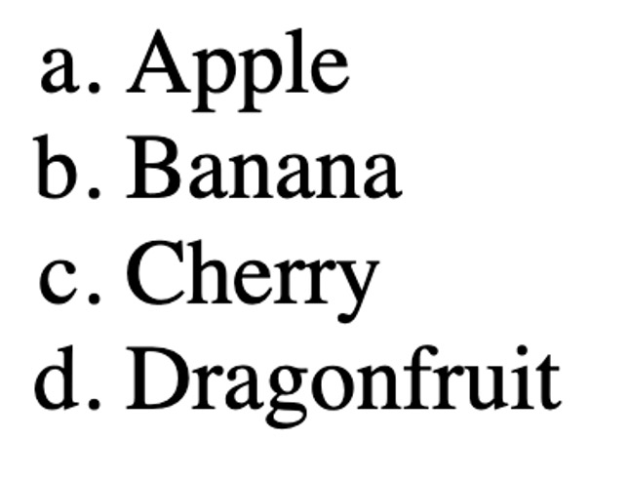
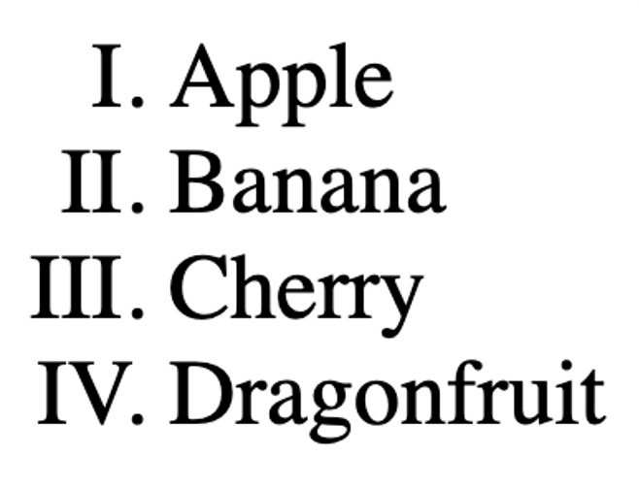

1.2 Types of Ordered Lists
Ordered Lists
Numeric: Default type, (1, 2, 3, ...) Attribute: type="1"
Uppercase Letters: (A, B, C, ...) Attribute: type="A"
Lowercase Letters: (a, b, c, ...) Attribute: type="a"
Uppercase Roman: (I, II, III, ...)
Attribute: type="I"
Lowercase Roman: (i, ii, iii, ...) Attribute: type="i"

Slide 87

1.3 Unordered Lists
Purpose: Used for lists where the order of items doesn't matter.
Default: Items are usually bulleted.
Nesting: Can be nested within other lists.

Slide 88

Level 5
List, Tables & Forms
2. Table Tag

Slide 89

2.1 <tr>, <td>, <th> Tags
<tr> Table Row : Used to define a row in an HTML table.
<th> Table Header : Used for header cells within a row. Text is bold and centered by default.
<td> Table Data : This Holds the actual data.

Slide 90

2.2 Captions
Purpose: Provides a title or description for a table.
Placement: Must be inserted immediately after the <table> opening tag.
Alignment: Centered above the table by default.
Accessibility: Helps screen readers understand the table's purpose.

Slide 91

2.3 Col Spans
Attribute: Uses the colspan attribute in <td> or <th> tags.
Purpose: Allows a cell to span multiple columns horizontally.
Alignment: Takes the space of the specified number of columns.
Layout: Useful for combining cells to create complex table layouts.

Slide 92

Level 5
List, Tables & Forms
3. Forms

Slide 93

3.1 Input Tag
Purpose: Used within a <form> element to collect user input.
Self-Closing: The <input> tag is self-closing; doesn't require a closing tag.
Attributes: Common attributes are name, value, placeholder, and required.

Slide 94

3.2 Action attribute
Purpose: Specifies the URL to which the form data should be sent when submitted.
Default: If not specified, the form will be submitted to the current page's URL.
Server-Side: Usually points to a server-side script (like PHP, Python, etc.) that processes the form data.

Slide 95

3.3 Name and Value property
`name` Property:
ID for Data: Identifies form elements when submitting.
Unique: Should be unique to each element for clarity.
`value` Property:
Default Data: Sets initial value for input elements.
Sent to Server: This is the data sent when form is submitted.

Slide 96

3.4 Label Tag
Purpose: Adds a text description to form elements.
for Attribute: Connects the label to a specific form element using the element's id.
Accessibility: Makes the form more accessible.
Readability: Enhances form readability and usability.

Slide 97

3.5 Input type: Date

Slide 98

3.5 Input type: File

Slide 99

3.5 Input type: Color

Slide 100

3.5 Input type: Range

Slide 101

3.5 Input type: Button

Slide 102

3.5 Input type: Submit

Slide 103

3.5 Input type: Radio

Slide 104

3.5 Input type: Checkbox

Slide 105

3.5 Input type: Select

Slide 106

3.5 Input type: TextArea
Purpose: <textarea> is used for multi-line text input in forms.
rows Property: Specifies the visible number of lines in the textarea.
cols Property: Sets the visible width measured in average character widths.
Resizable: Some browsers allow users to manually resize the textarea.

Slide 107

Level 5
List, Tables & Forms
4. iFrame Tag

Slide 108

4.1 Using iFrames
Embedded Content: Allows you to embed another webpage or multimedia content within a webpage.
src Attribute: Specifies the URL of the content to be embedded.
Dimensions: Width and height can be set using width and height attributes.

Slide 109
Level 5 Revision
List, Tables & Forms
List Tag
Ordered Lists
Types of Ordered Lists
Unordered Lists
Table Tag
<tr>, <td>, <th> tags
Captions
Col spans
Forms
Input tag
Action Attributes
Name and Value Property
Label Tag
Exploring Types
iFrame Tag
Using iFrames

Slide 110
Project Level 5
List, Tables & Forms
Create a page with all type of ordered list and one unordered list.
Create a table with headings,
captions and a few rows. One of heading should take at least 3 columns.
Create a contact me form with relevant details for your resume
website.
Use iFrame to add this video to your page.

Slide 111

Level Bonus
Github Pages & CodeSpace
Github
What is Version Control
What is Git and GitHub
Account Creation
Creating a Repo
Creating a Codespace
Creating a Github page
Publishing our project
FrameWorks
React
Angular
Vue

Slide 112

Level Bonus
Github Pages & CodeSpace
1. GitHub

Slide 113

1.1 What is Version Control
Definition: A system to track changes in files over time.
Types: Centralized (like SVN) and Distributed (like Git).
Purpose: Helps in teamwork and fixes mistakes.
Snapshots: Each 'commit' saves a file version.
Branching: Lets you work on different tasks separately.
Merge: Combines changes from different people.
Undo: Easy to revert to older file versions.

Slide 114


1.2 What is Git and GitHub
What is Git?
Definition: A software tool that tracks changes in code, enabling collaboration and version control.
Commit: Records a snapshot of file changes.
Branch: Allows separate paths of development.
Merge: Combines changes from different branches.
What is GitHub?
Definition: A web service for hosting and collaborating on Git repositories.
Fork: Creates a personal copy of another user's repository.
Pull Request: A way to propose changes to existing code.
Issues: Used for tracking bugs and feature ideas.

Slide 115

1.3 Account Creation

Slide 116

1.4 Creating a Repo

Slide 117

1.5 Creating a CodeSpace

Slide 118

1.6 Creating a Github Page

Slide 119

1.7 Publishing our Project

Slide 120

Level Bonus
Github Pages & CodeSpace
2.
Frameworks

Slide 121

3.1 ReactJS
Definition: A tool for making websites interactive.
Components: Reusable pieces for building a webpage.
Virtual DOM: Makes websites faster by updating only what's needed.
JSX: A special way to write code that looks like HTML.
State: Keeps track of changes on the
webpage.
Props: Shares information between different parts of a webpage.

Slide 122

3.2 AngularJS
Definition: A framework for building web applications, developed by Google.
Two-Way Data Binding: Updates both the view and the model simultaneously.
Directives: Custom HTML tags for added functionality.
Dependency Injection: Automatically manages
how parts of the app work together.
Controllers: Manages the data for a specific part of the webpage.
SPA Support: Good for Single Page
Applications where the page doesn't reload.

Slide 123

3.3 VueJS
Definition: A JavaScript framework for creating web interfaces.
Components: Small, reusable parts for building a website.
Reactivity: Automatically updates the webpage when data changes.
Directives: Special tokens in HTML for added functionality.
Vuex: Helps manage shared data across the
site.
Single-File Components: Keeps template, script, and style in one file.

Slide 124
Level Bonus Revision
Github Pages & CodeSpace
Github
What is Version Control
What is Git and GitHub
Account Creation
Creating a Repo
Creating a Codespace
Creating a Github page
Publishing our project
FrameWorks
React
Angular
Vue

Slide 125
Level Bonus Project
Github Pages & CodeSpace
Create a Github account if you don’t have one.
Create a repo for the project you have done till now.
Create a Codespace and make changes.
Publish it using Github pages.

Slide 126
Major Project
Idea
Create your Resume or Portfolio website.
Create a repo in Github.
Publish it on Github pages.
Add the link to your resume.
Add the link in the comment section.

